Slide 1
Distributed Systems
Fenglyu Lin
July 3 2024
Notes:
This is a very very big topic, I cannot cover each point one by one in this short time.

Slide 2
TOC
Why Distributed Systems?
Two-Generals’ Problem
RPC semantics
Distributed State & Consistency
Fault Tolerance & State Machine Replication
Consensus & Consensus Protocol
Distributed Transaction
More
Q&A

Slide 3
Why distributed systems?

Slide 4
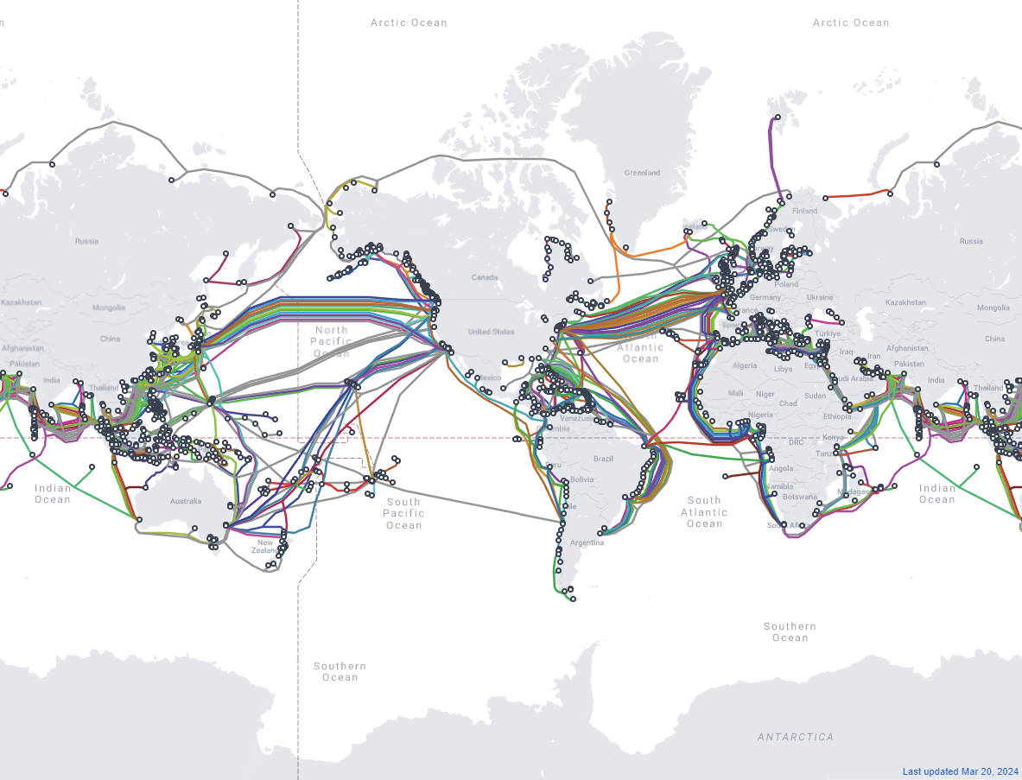
Why Distributed Systems?

Slide 5
Why Distributed Systems?
Performance
Scalability
Fault Tolerance
Notes:
I believe you all can name many reasons

Slide 6
Quick view for the topics

Slide 7
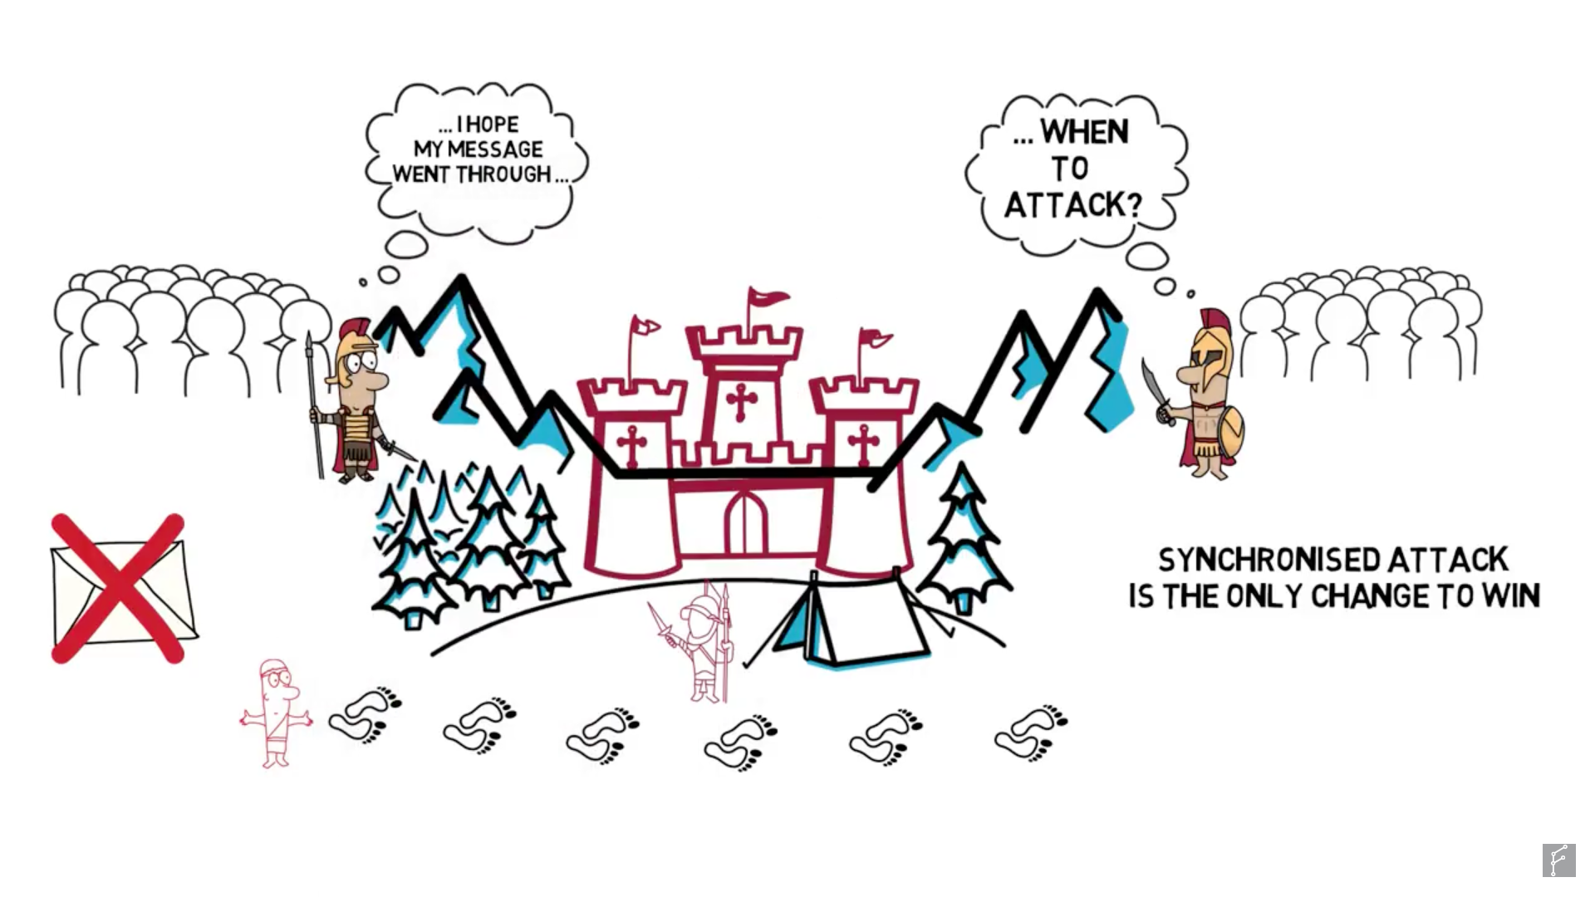
Two Generals’ Problem

Slide 8
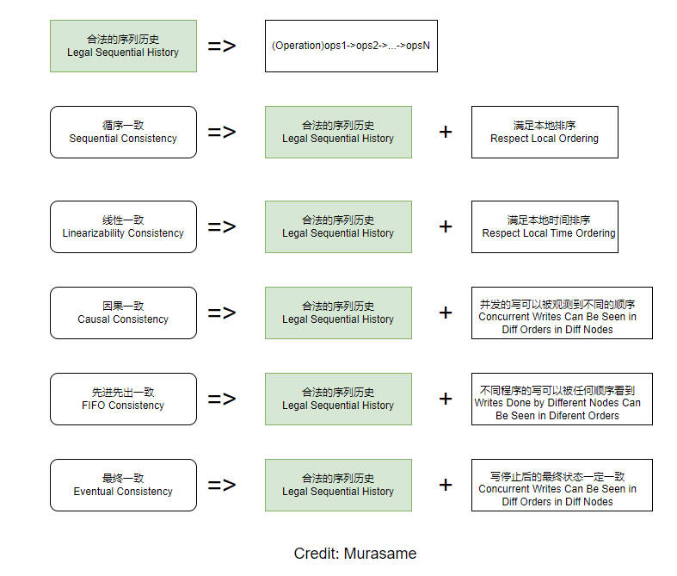
Consistency

Slide 9
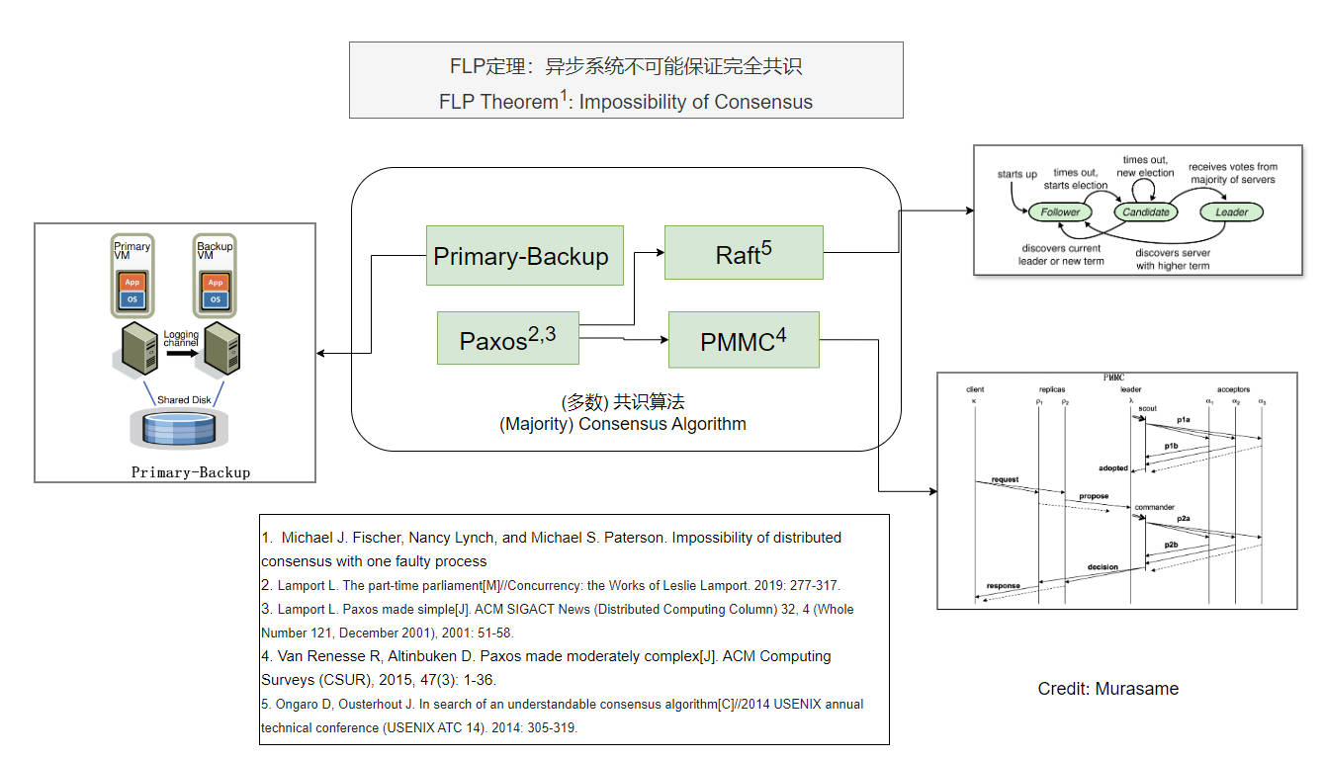
Fault Tolerance & Consensus Protocols

Slide 10
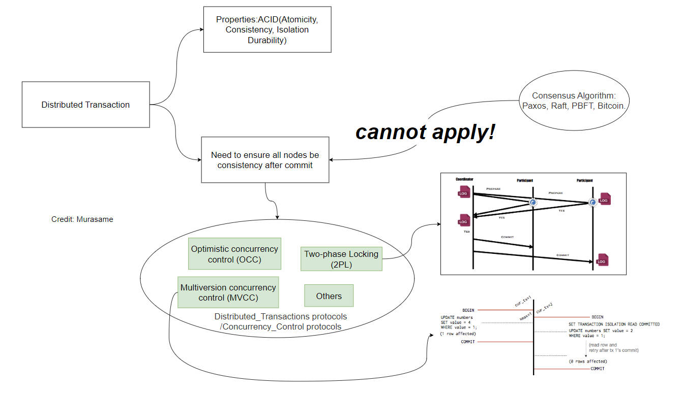
Distributed Transaction

Slide 11
TOC
Why Distributed Systems?
Two-Generals’ Problem
RPC semantics
Distributed State & Consistency
Fault Tolerance & State Machine Replication
Consensus & Consensus Protocol
Distributed Transaction
More
Q&A

Slide 12
Two Generals’ Problem

Slide 13
Two-Generals’ Problem
Classic thought experiment
Two generals plan to attack the enemy.
They win only when they attack at the same time.
Send messengers to communicate the time, but messengers may be captured on the way.
Notes:
Some authors also refer to this as the Two Generals' Paradox, the Two Armies Problem, or the Coordinated Attack Problem

Slide 14
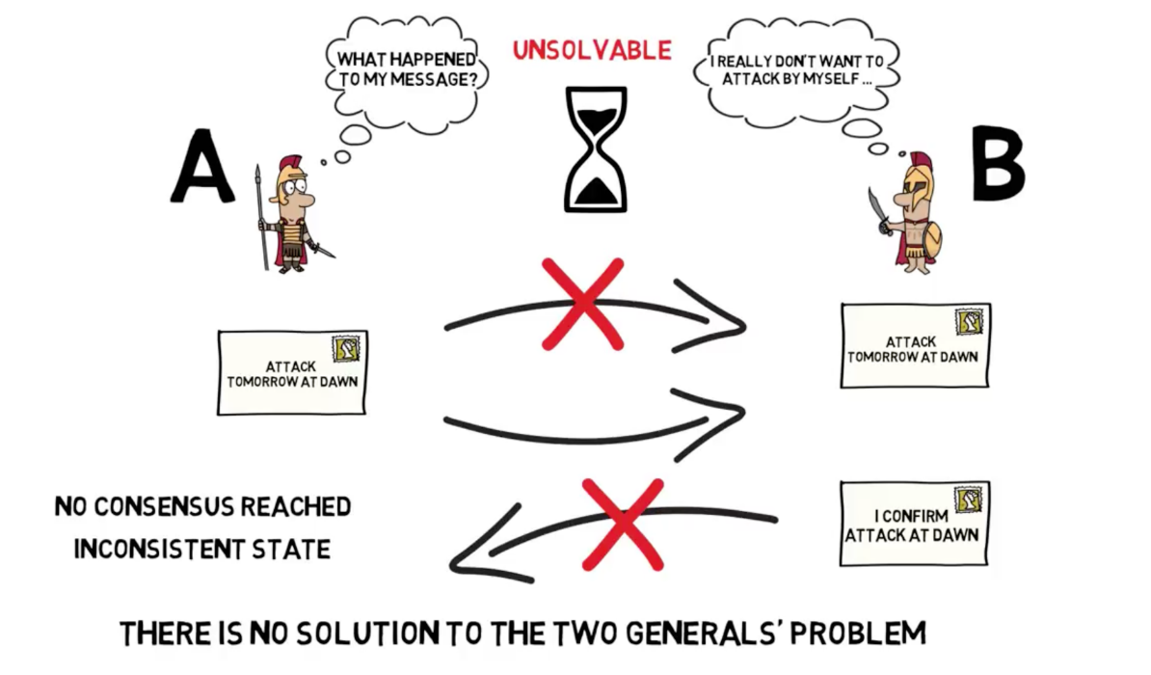
Two-Generals’ Problem: Unresolvable
Ack of msg and Ack of ack may be lost. Can’t have an agreement of attack timing.
Notes:
https://finematics.com/two-generals-problem/

Slide 15
Two Generals’ Problem
This problem is a thought experiment that remains unresolvable
It is impossible to reach a Consensus and consistent state on a unreliable tunnel.

Slide 16
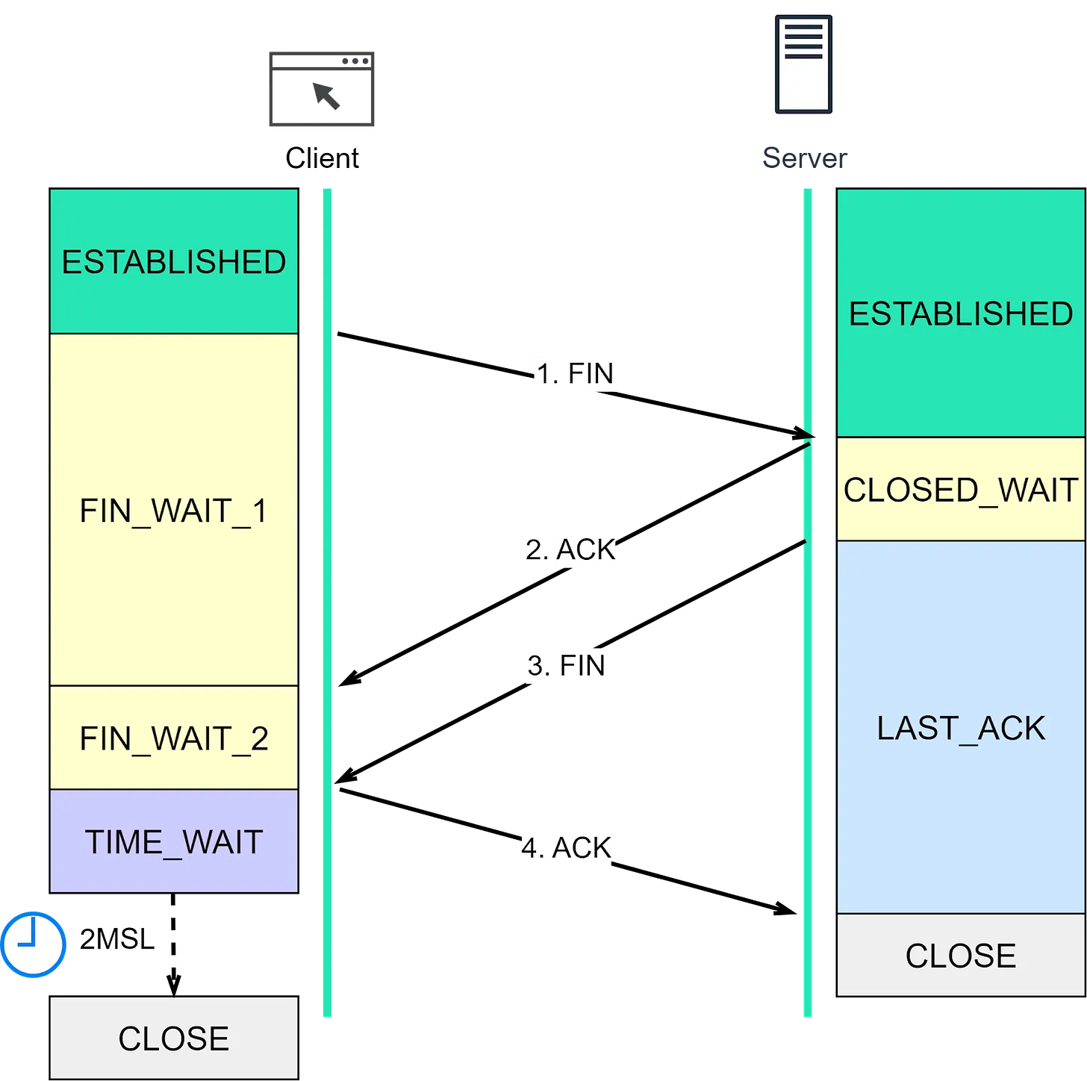
Two Generals’ Problem
TCP provides reliable data transfer, can we resolve the Two Generals’ Problem based on TCP tunnel? Why?
Cannot.
The reliability of TCP is built on auto-retry, it ensures the data is transmitted with a high probability.
TCP cannot guarantee 100% consistent status among two Generals. because the infinite ACK is unavoidable.
For example
The last ACK is lost,
The server retries FIN, also lost
After 2MSL the client is closed, but server never know whether the client receives the FIN.
X
Notes:
The FIN request may be lost

Slide 17
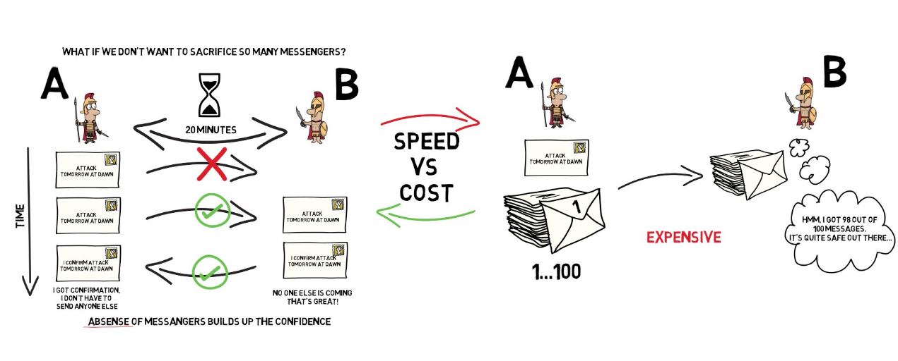
Two-Generals’ Problem: Solutions in engineering way
The right solution (send 100 messengers) can be built in TCP.
These is so-called engineering way, it risks a bit risk that the
Notes:
The right solution (send 100 messengers) can be built in TCP.
This is so-called engineering way, it risks a bit risk that the

Slide 18
TOC
Why Distributed Systems?
Two-Generals’ Problem
RPC semantics
Distributed State & Consistency
Fault Tolerance & State Machine Replication
Consensus & Consensus Protocol
Distributed Transaction
More
Q&A

Slide 19
RPC Semantics

Slide 20
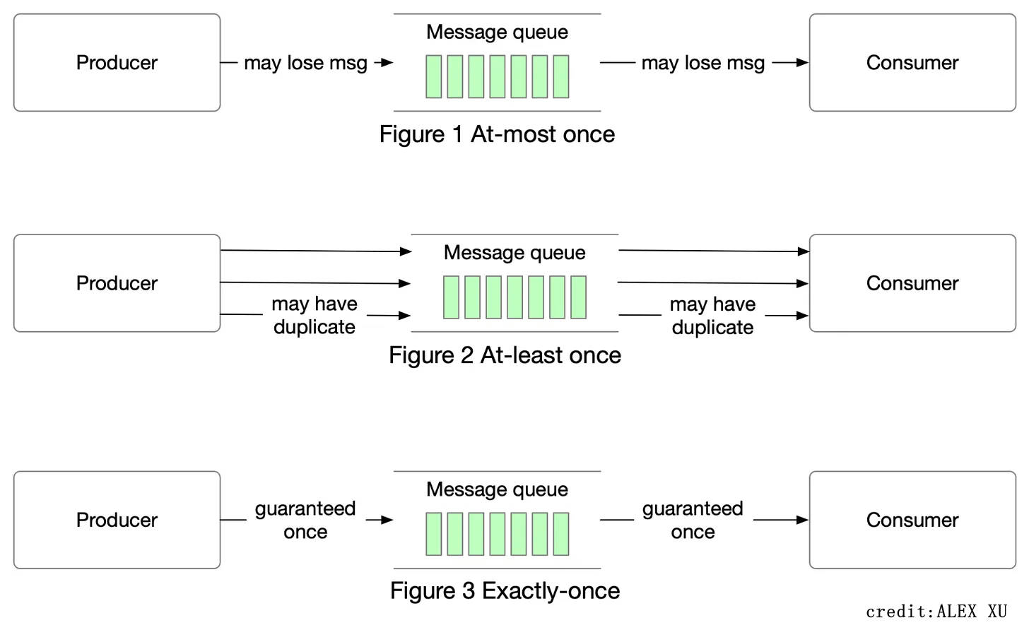
RPC Semantics

Slide 21
RPC Semantics
At-least-once
Request is send and received on the server one or multiple times.
It is useful when the operation is idempotent, otherwise unuseful.
Implementation
Client retries until receiving response from server
At-most-once
Request is executed on the server once.
Exactly-once
Request is sent and received exactly once.
Implementation
Theoretically impossible.
Engineering Implementation
Client sends request(seq_id) to server
Client retries until receiving response from server
Server will need to cache the response for each request(seq_id) and send back

Slide 22
RPC Semantics: Quiz
Why Exactly-once is impossible in theory?
Msg may be lost.
Server may crash while receiving/processing the request.
Can TCP support exactly-once?
No, it ensures the data is transmitted with a high probability.
How does Kafka ensure Exactly-once?
Produce msg
Retry mechanism
enable.idempotence=true, unique producer_id +sequnce_number per msg
Consume msg
Transactional consumption and commit offset.

Slide 23
TOC
Why Distributed Systems?
Two-Generals’ Problem
RPC semantics
Distributed State & Consistency
Fault Tolerance & State Machine Replication
Consensus & Consensus Protocol
Distributed Transaction
More
Q&A

Slide 24
Distributed State

Slide 25
Distributed State
Distributed State is “Information retained in one place that describes something, or is determined by something, somewhere else in the system”
Benefits of distributed state
Performance
Reliability
Coherence

Slide 26
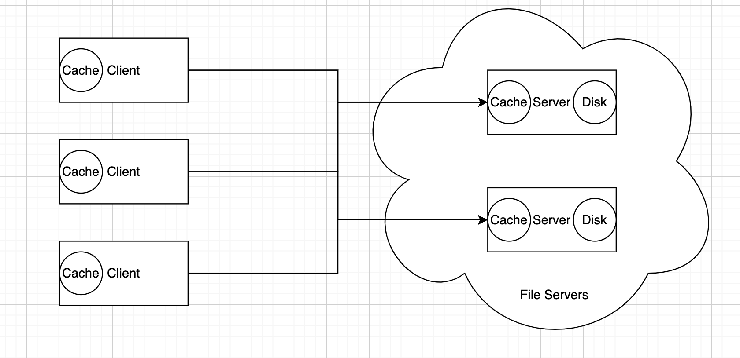
Distributed State
“Information retained in one place that describes something, or is determined by something, somewhere else in the system”

Slide 27
Consistency

Slide 28
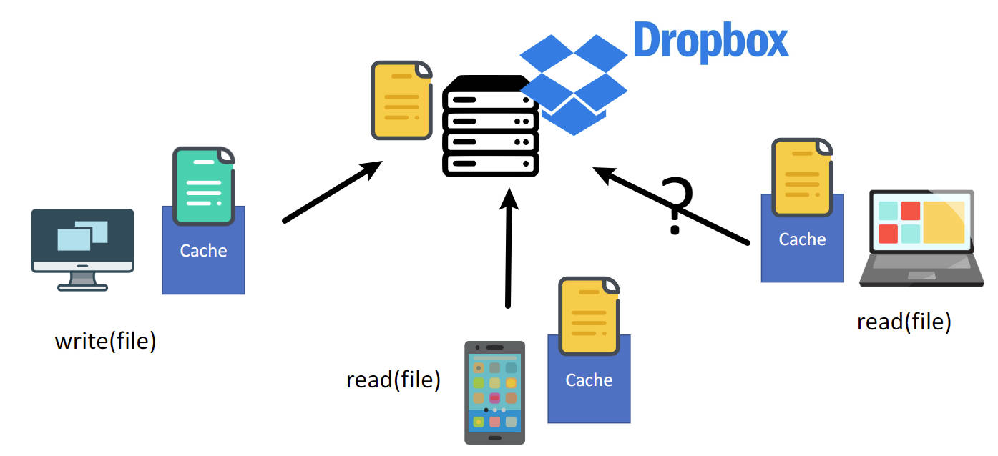

Slide 29
Consistency
How do we define and compare consistency between different behaviours?
Is it okay to see the stale value?
Should we must read the latest data?
What if there is concurrent write request, which data should we read?
Apparently, we need formal semantics.

Slide 30
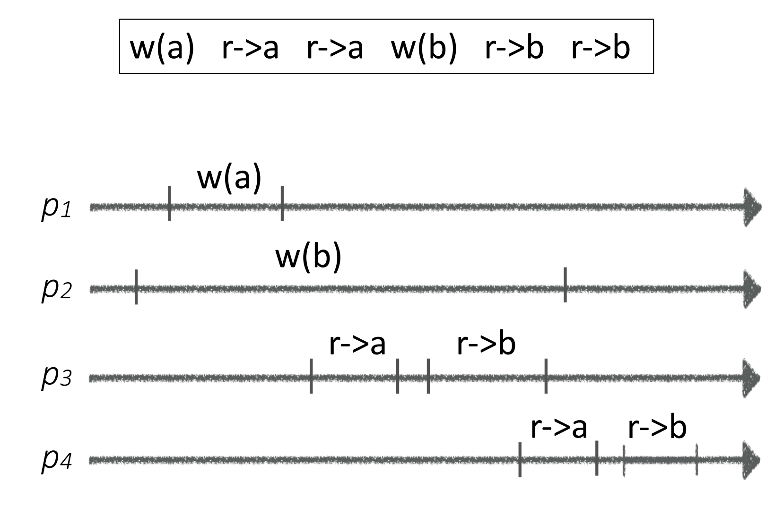
Consistency
Consistency: the allowed semantics (return values) of a set of operations to a data store or shared object.
A safety property: specifies the bad things that shouldn’t happen in any execution.
It specifies the interface, not the implementation.
Anomaly: violation of consistency semantics
Notes:
Performance
• Consistency requires synchronization/coordination when data is
cached/replicated
• Often slower to make sure you always return the right answer
• Availability
• What if client is offline, or network is not working
• Weak/eventual consistency may be the only option
• Programmability
• Weaker models are harder to reason against

Slide 31
Consistency
Strength & Weakness
Strong Consistency: behaves like a single instance
Weak Consistency: behaves diff from single instance
Eventual Consistency: the weak consistency(aberrant) are temporary

Slide 32
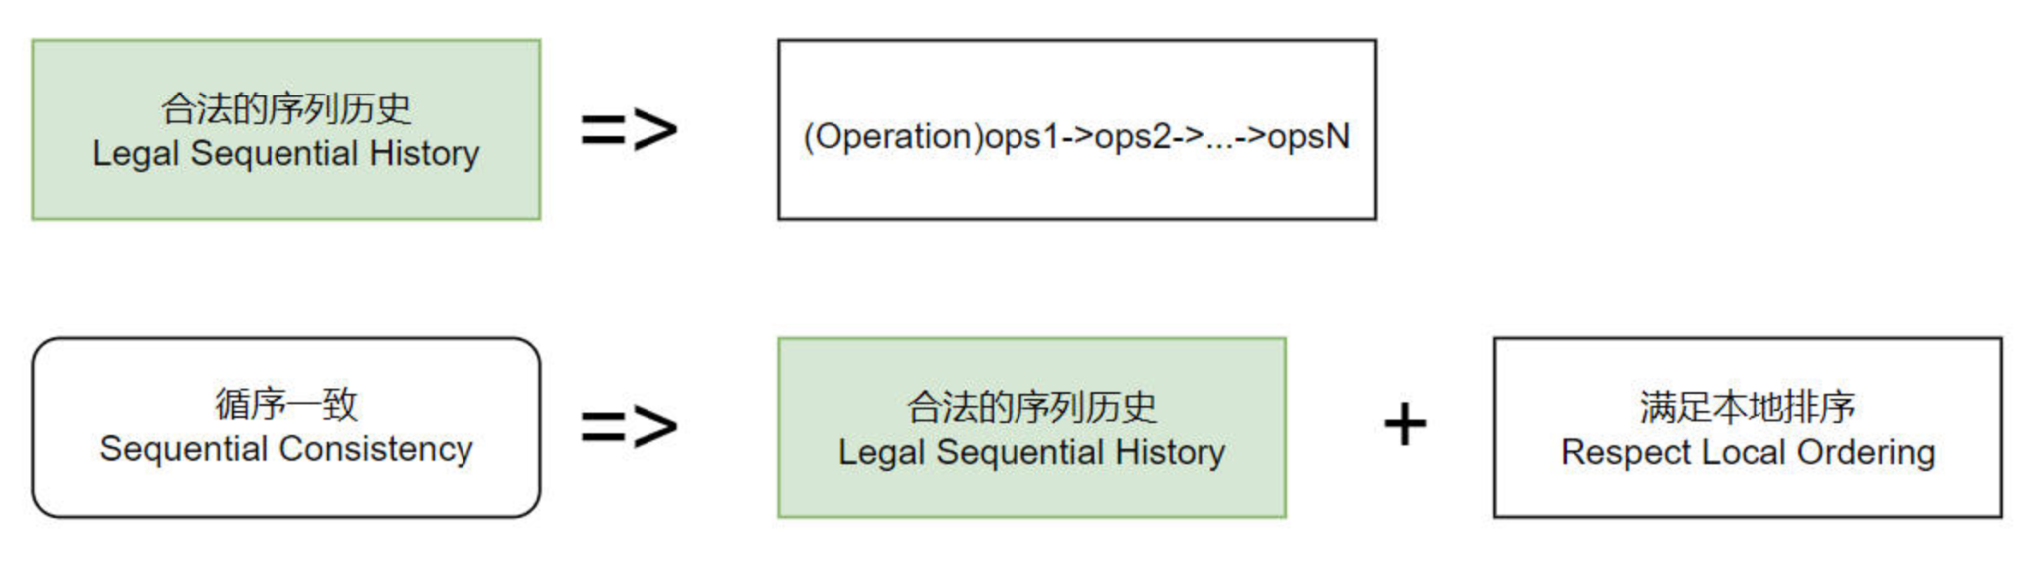
Consistency
Two important consistency definition
Sequential Consistency(Serializability): Requires that a history of operations be equivalent to a legal sequential history, where a legal sequential history is one that respects the local ordering at each node.

Slide 33
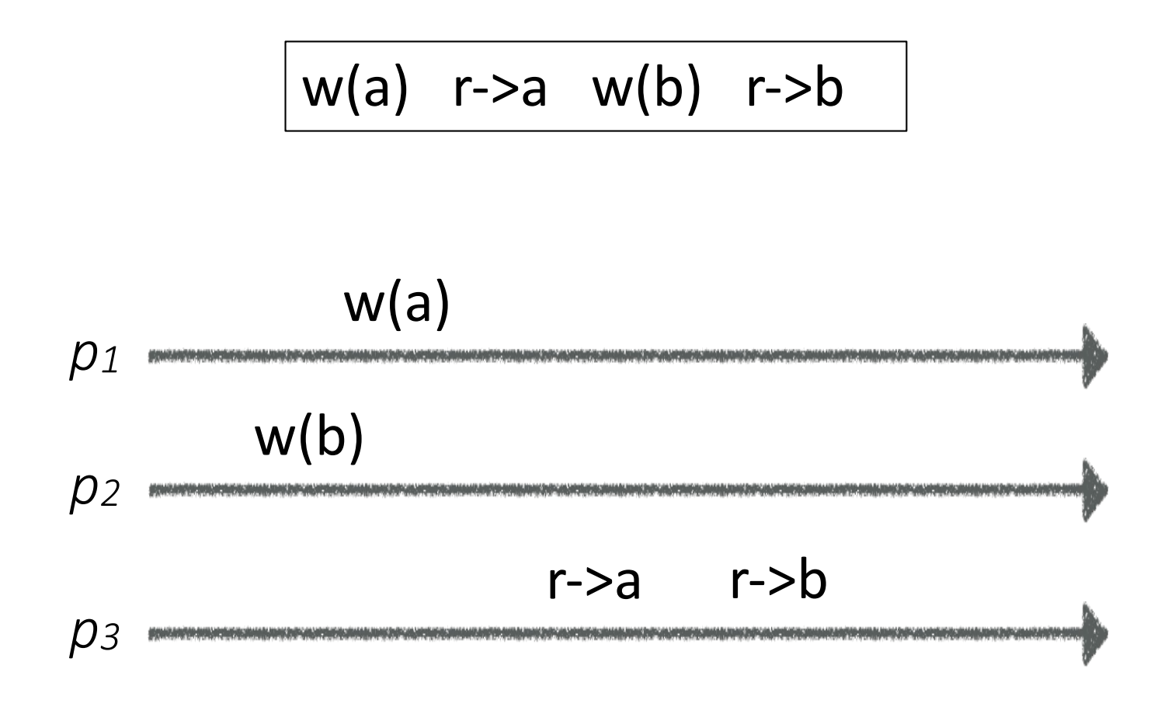
Consistency: Sequential Consistency
YES!
Single register
Process writes/reads
Read must be before Write
1. Legal History
2. Respect Local Ordering

Slide 34
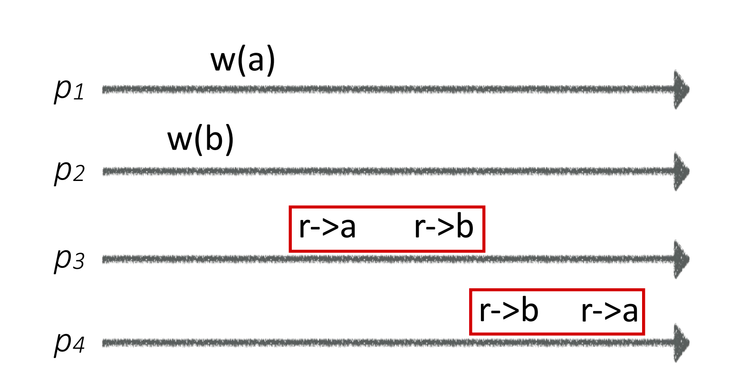
Consistency: Sequential Consistency
No!
Single register
Process writes/reads
Read must be before Write
We cannot find a Legal History
respects Local Ordering

Slide 35
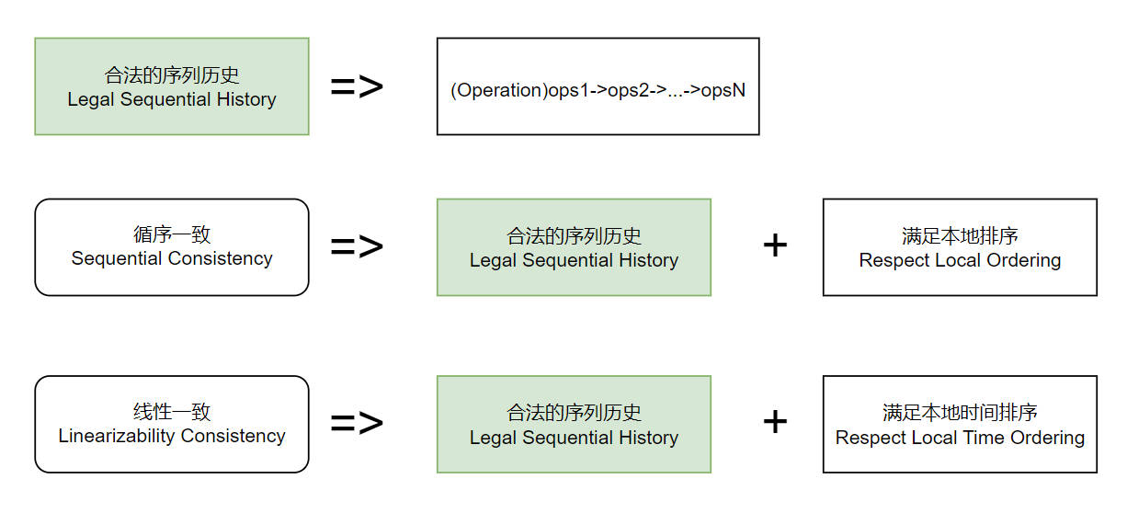
Consistency
2. Linearizable Consistency(Linearizability): Sequential Consistency + respect real-time ordering.
It behaves like there is a single copy of data.
One of the strongest consistency.

Slide 36
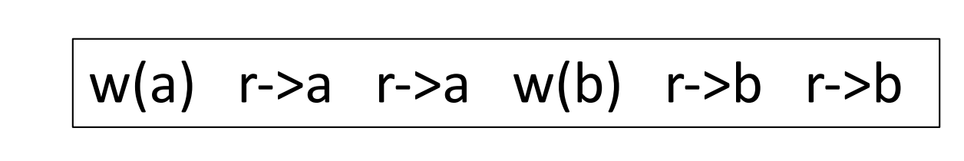
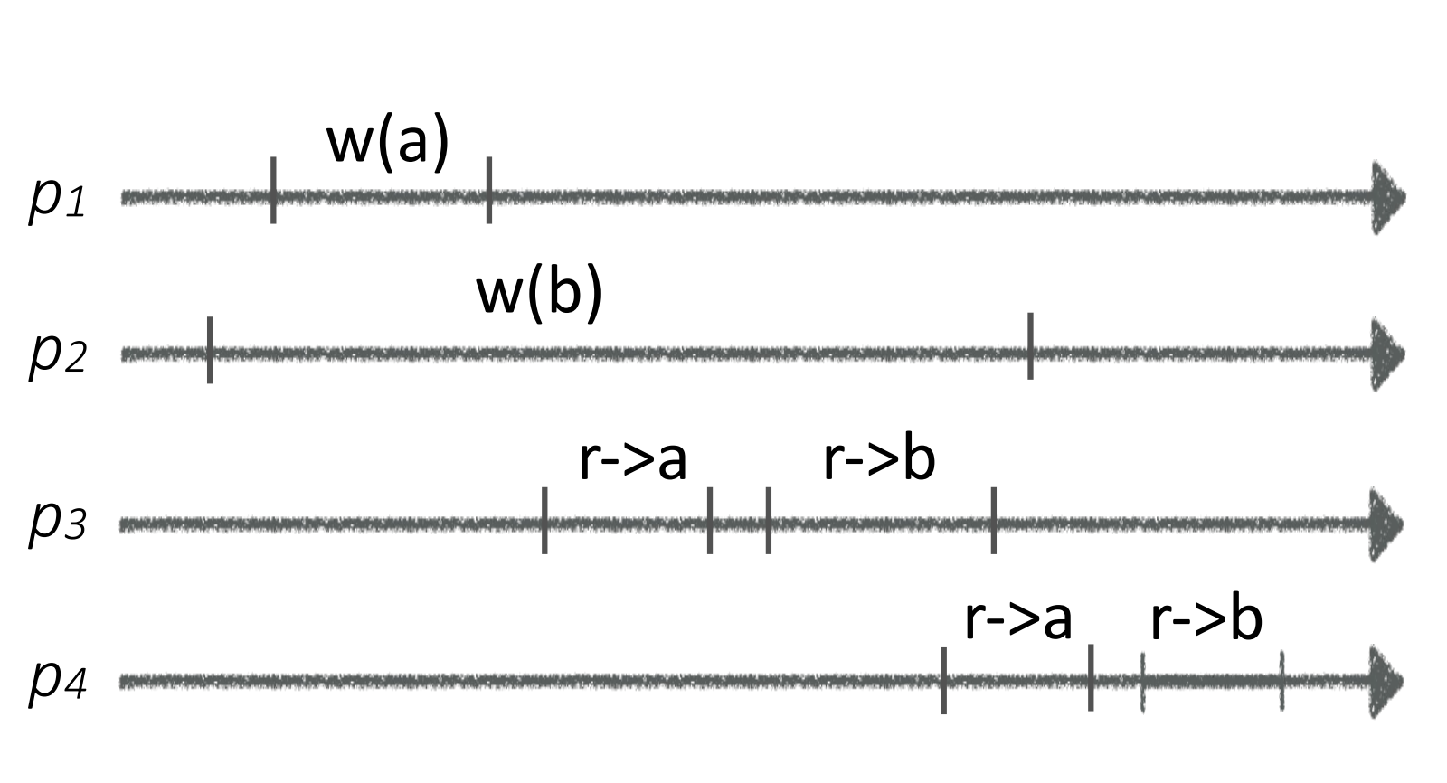
Consistency
YES

Slide 37
Consistency
The difference between them
Sequential consistency allows operations to appear out of real-time order.
The most common way systems are sequentially consistent but not linearizable is by allowing read-only operations to return stale data.

Slide 38
More Consistency
Other types of consistency
Causal Consistency: Writes that are not concurrent must be seen in order, concurrent writes can be seen in different orders on different nodes.
FIFO Consistency: Writes done by the same process are seen in that order; writes by different processes can be seen in different orders.
Eventual Consistency: if all writes to an object stop, eventually all processes read the same value.

Slide 39
TOC
Why Distributed Systems?
Two-Generals’ Problem
RPC semantics
Distributed State & Consistency
Fault Tolerance & State Machine Replication
Consensus & Consensus Protocol
Distributed Transaction
More
Q&A

Slide 40
Fault Tolerance

Slide 41
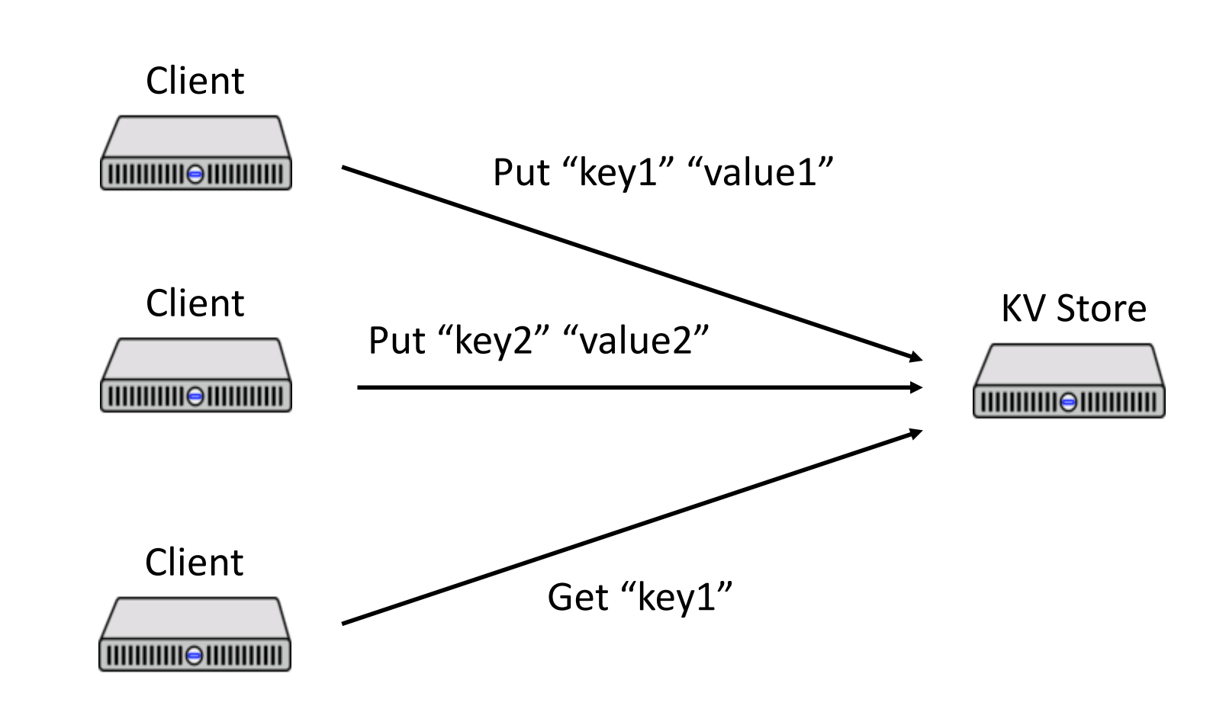
Fault Tolerance
Single Instance:
X

Slide 42
Fault Tolerance
To support single point fault tolerance
Replicate the state machine across multiple servers
Clients can view all servers as one state machine
This approach is so called SMR (State Machine Replication)
Primary and Backup
Consensus Protocols

Slide 43
Primary & Backup

Slide 44

Primary & Backup
At any time:
Client talks to the server, the primary
The data of primary if replicated to backup
If the primary fails, the backup becomes primary
Goals:
Correct and available, behaves like a single copy
Despite failures(Crash, Network issues, etc)

Slide 45
Primary & Backup
Basic Operations
Clients send operations (Put, Get, Append) to primary
Primary decides on order of ops
Primary forwards sequence of ops to backup
Backup performs ops in same order
After backup has executed/saved ops, primary replies to client

Slide 46
Primary & Backup
Challenges
Server may crashes
There can be only one Primary at a time
State transfer between Primary and Backup
Log operations? Content of memory?
Think about the binlog of MySQL
Lost/delay/duplicate messages

Slide 47
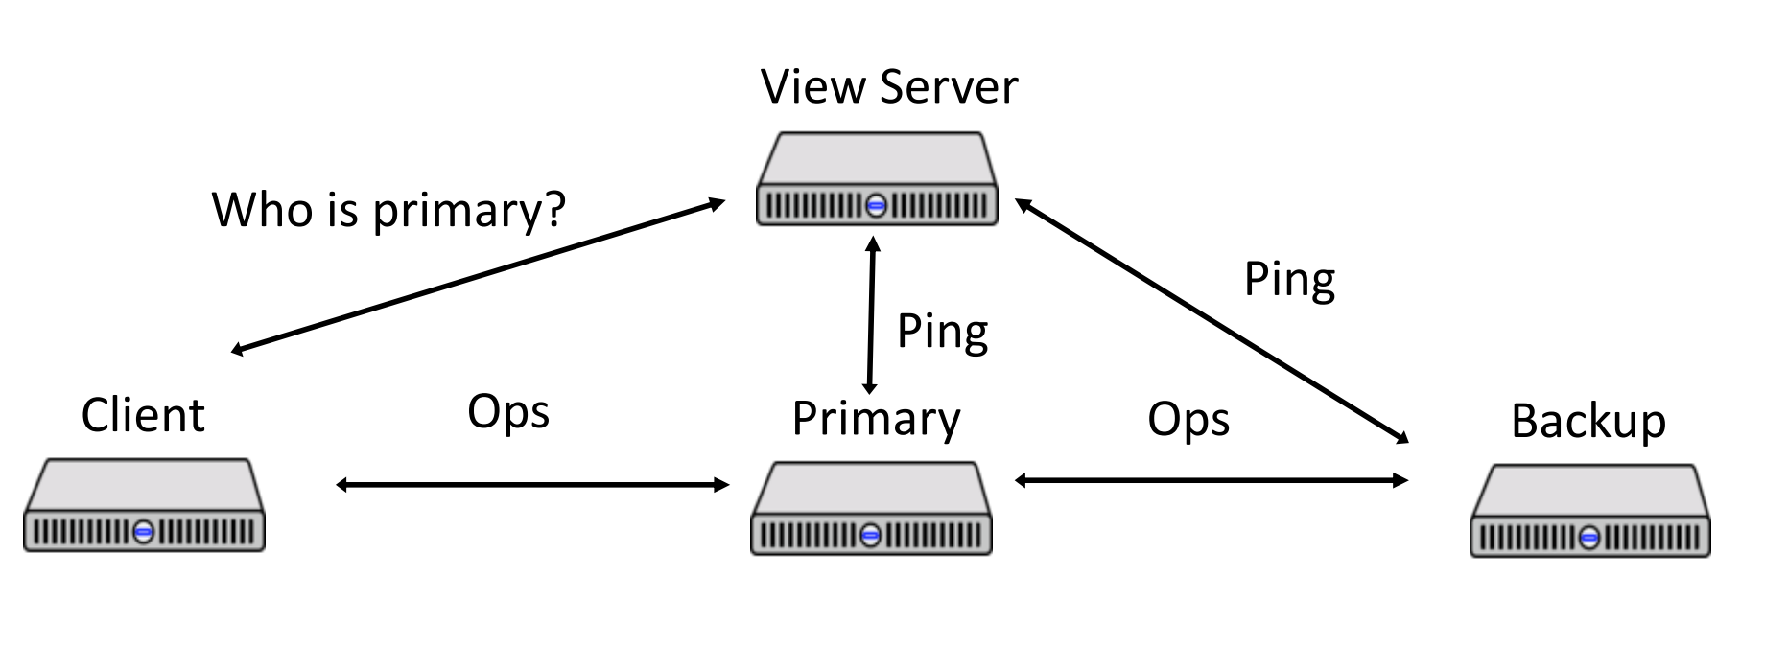
Primary & Backup
To manage the replicate states, deal with server failures.
We introduce the View Server.
View Server decides who is primary, backup, or idle server.

Slide 48
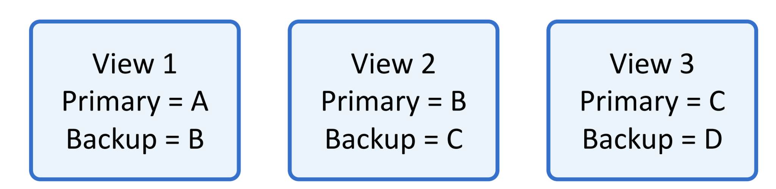
Primary & Backup
A view is a statement about the current roles in the system
View Server detects the server failures by heartbeats
Each server periodically calls view server
Dead if missed in Pings
Live after a single Ping
On primary fails
Set Backup as Primary
Promote Idle as Backup
Primary transfer data to Backup
On backup fails
…
Notes:
If more than two servers are live, extras are “idle”

Slide 49
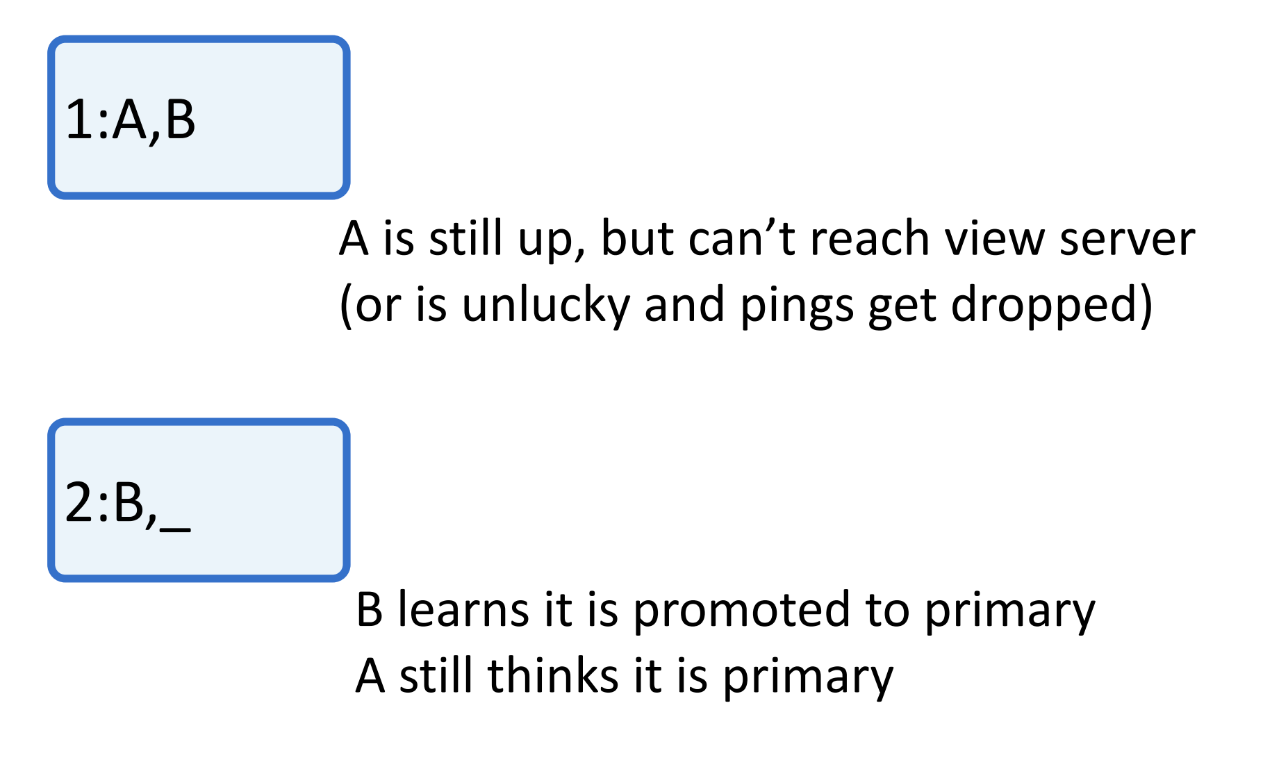
Primary & Backup
Question
Can more than one server think it is Primary? (Split-brain)
YES, due to network issues
Notes:
If more than two servers are live, extras are “idle”

Slide 50
Primary & Backup
Rules
Primary in view i+1 must have been backup or primary in view i
Primary must wait for backup to accept/execute each op before replying to client
Backup must accept forwarded requests only if view is correct
Non-primary must reject client requests
Every operation must be before or after state transfer
So no more Split-Brain Problem
Notes:
If more than two servers are live, extras are “idle”

Slide 51
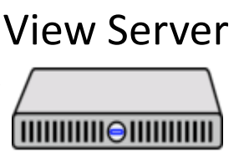
Primary & Backup
The drawback of Primary & Backup
View Server have single point of failures.
If replicate view server, then we have to add another view server for them..
How to resolve this?

Slide 52
TOC
Why Distributed Systems?
Two-Generals’ Problem
RPC semantics
Distributed State & Consistency
Fault Tolerance & State Machine Replication
Consensus & Consensus Protocol
Distributed Transaction
More
Q&A

Slide 53
Consensus Protocols

Slide 54
Consensus Protocols

Slide 55
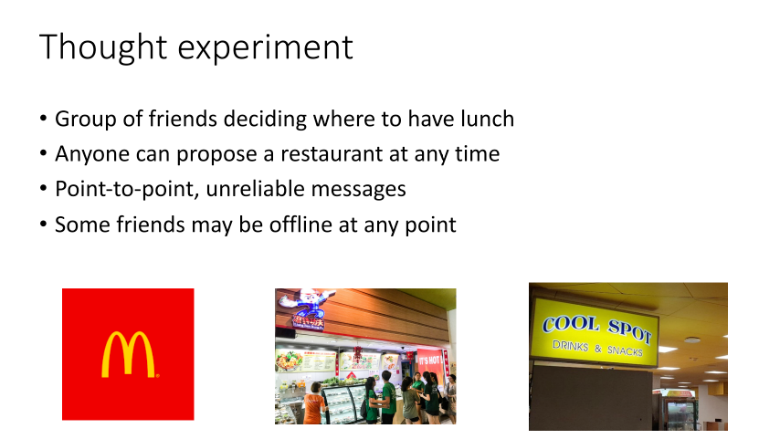
Consensus Protocols

Slide 56
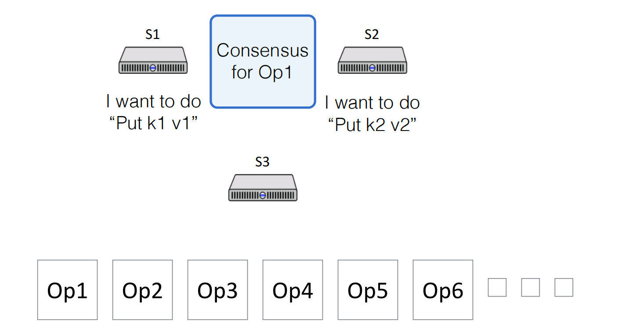
Consensus Protocols

Slide 57

Consensus Protocols
Distributed Consensus:
A procedure for a number of processes to agree on a single proposal made by one of them.
Should eventually and only choose one value.
There are many proposed protocols to reach consensus
One famous protocol is Paxos
It address the Primary & Backup problem by majority
Majority: more than half of the participants
Majority Intersect: for any two majorities S and S’, there is some node in both S and S’

Slide 58
Consensus Protocols
Paxos Roles
Proposers
Propose values (proposals) to be chosen
Acceptors
Accept/reject proposals
Collectively decide when a value is chosen
Learners
Once a value is chosen, learn the decided value
All logical roles
Multiple roles can co-locate on the same physical node

Slide 59
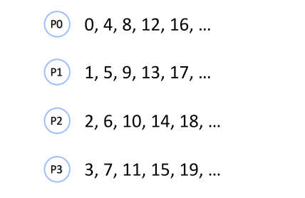
Consensus Protocols
Paxos Terminology
Value: a possible value/operation to reach consensus on
Proposal: to select a value, the proposals are uniquely numbered
Accept: A proposal/value is accepted by acceptor
Chosen: A proposal/value is chosen by majority
Learned: acceptors need to know the proposals is chosen

Slide 60
Consensus Protocols
Implementation of Paxos, to reach consensus, choose a Value
V: Value; N: Proposal number;
Phase 1:
P1a: Proposer chooses a new n and sends the <prepare, n> to a majority of Acceptor.
P1b: If an acceptor a receives<prepare,n’>, where n’ > n of any <prepare,n> to which it has responded, then it responds to <prepare, n’> with
A promise not to accept any more proposals numbered less than n
The highest-numbered proposal (if any) that it has accepted
Phase 2:
P2a: If the proposer receives a response to <prepare,n> from a majority of acceptors, then it sends to each <accept,n,v>, where v is either
The value of the highest-numbered proposal among the responses
Any value if the responses reported no proposals
P2b: If an acceptor receives <accept,n,v>, it accepts the proposal unless it has in the meantime responded to <prepare,n’> , where n’ > n

Slide 61
Consensus Protocols
P1a: proposer sends <prepare>
P0
(nil,nil)
p1a<0>
P1a: Proposer chooses a new n and sends the <prepare, n> to a majority of Acceptor.
P1
(nil,nil)
P2
(nil,nil)
P3
Proposer
Acceptor

Slide 62
Consensus Protocols
P1b: acceptor receives preparesends back <response>
P0
p2b<0,nil>
(0,nil)
p2b<0,nil>
P1b: If an acceptor a receives<prepare,n’>, where n’ > n of any <prepare,n> to which it has responded, then it responds <response> to <prepare, n’> with
A promise not to accept any more proposals numbered less than n
The highest-numbered proposal (if any) that it has accepted
P1
(0,nil)
P2
(nil,nil)
P3
Proposer
Acceptor

Slide 63
Consensus Protocols
P2a: proposer receives <response> and sends <accept, “A”>
P2a: If the proposer receives a response to <prepare,n> from a majority of acceptors, then it sends to each <accept,n,v>, where v is either
The value of the highest-numbered proposal among the responses
Any value if the responses reported no proposals
P0
(0,nil)
p2a<0,”A”>
P1
(0,nil)
P2
(nil,nil)
P3
Proposer
Acceptor

Slide 64
Consensus Protocols
P2b: acceptor accepts the proposal
P2b: If an acceptor receives <accept,n,v>, it accepts the proposal unless it has in the meantime responded to <prepare,n’> , where n’ > n
P0
(0,”A”)
p2a<0,”A”>
P1
(0,”A”)
P2
(nil,nil)
P3
Proposer
Acceptor

Slide 65
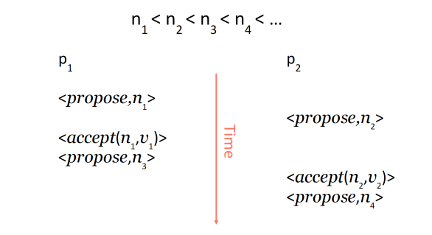
Problem
Liveness is not guaranteed because of race conditions of proposal conflictins.
Solution? Have a stable/distinguished Leader

Slide 66
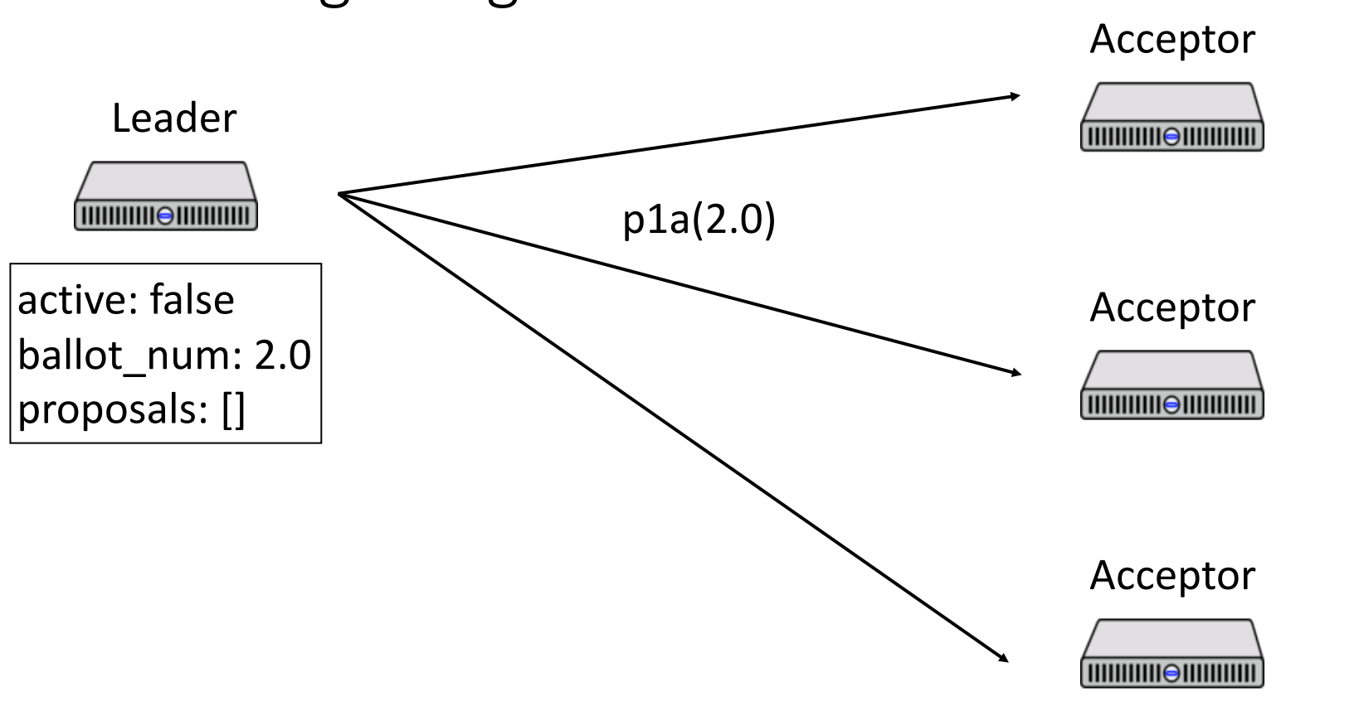
PMMC: Paxos made moderate complex
Published in 2015
Roles: Replica, acceptor, leader
PMMC has a stable leader
Leader “election” by running Paxos Phase 1 for all instances
Normal case: only needs to run Paxos Phase 2 protocol
If leader fails?
The follower finds there is no heartbeats from leader for a while, timeout.
They will elect themselves as leader if didn’t receive others’ election

Slide 67
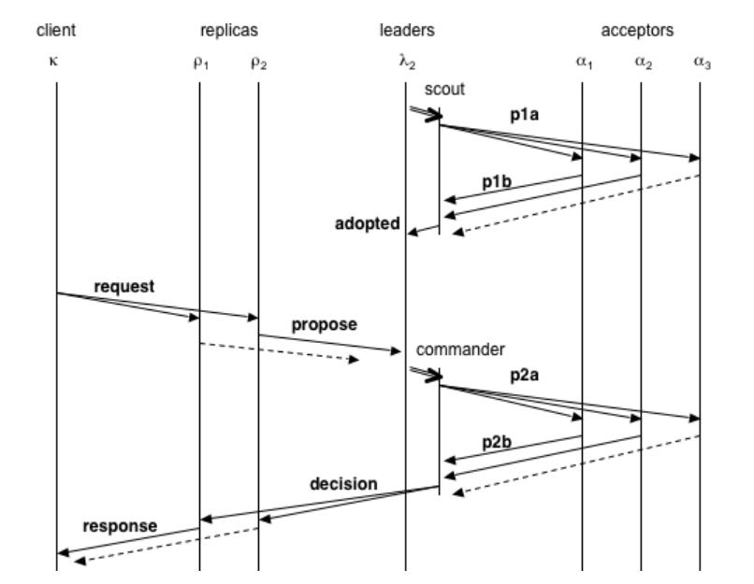
PMMC: Paxos made moderate complex

Slide 68
Raft
Leader election per term
Log replication
Leader replicates log to all followers
Restrictions on leader election to enforce safety

Slide 69
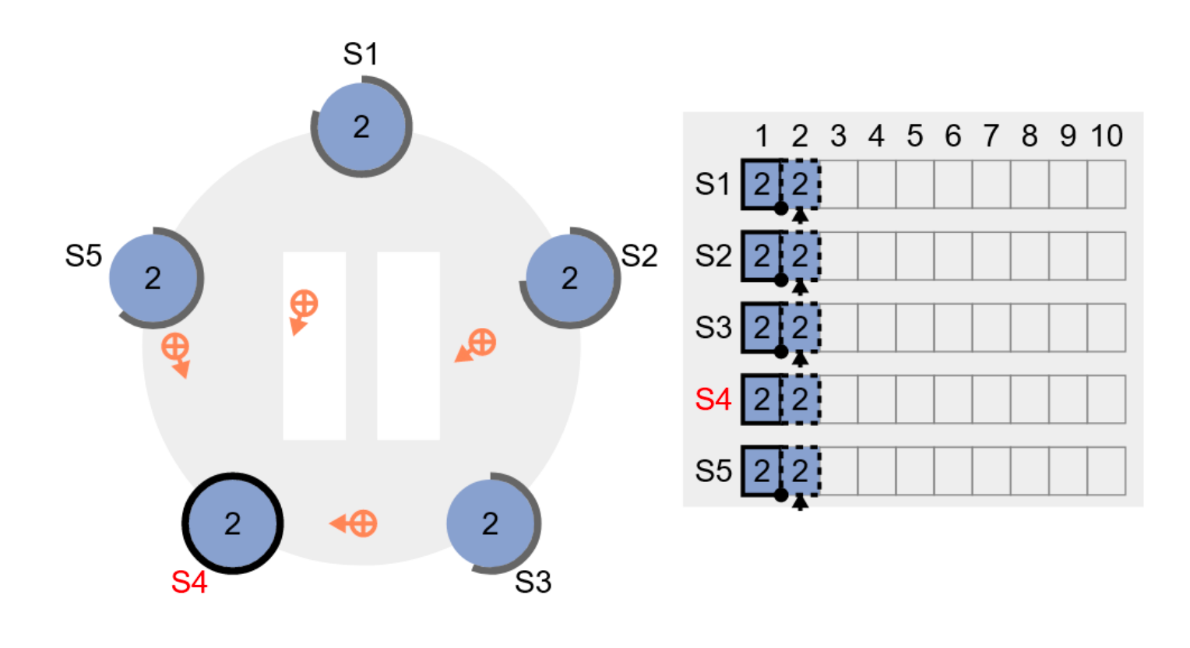
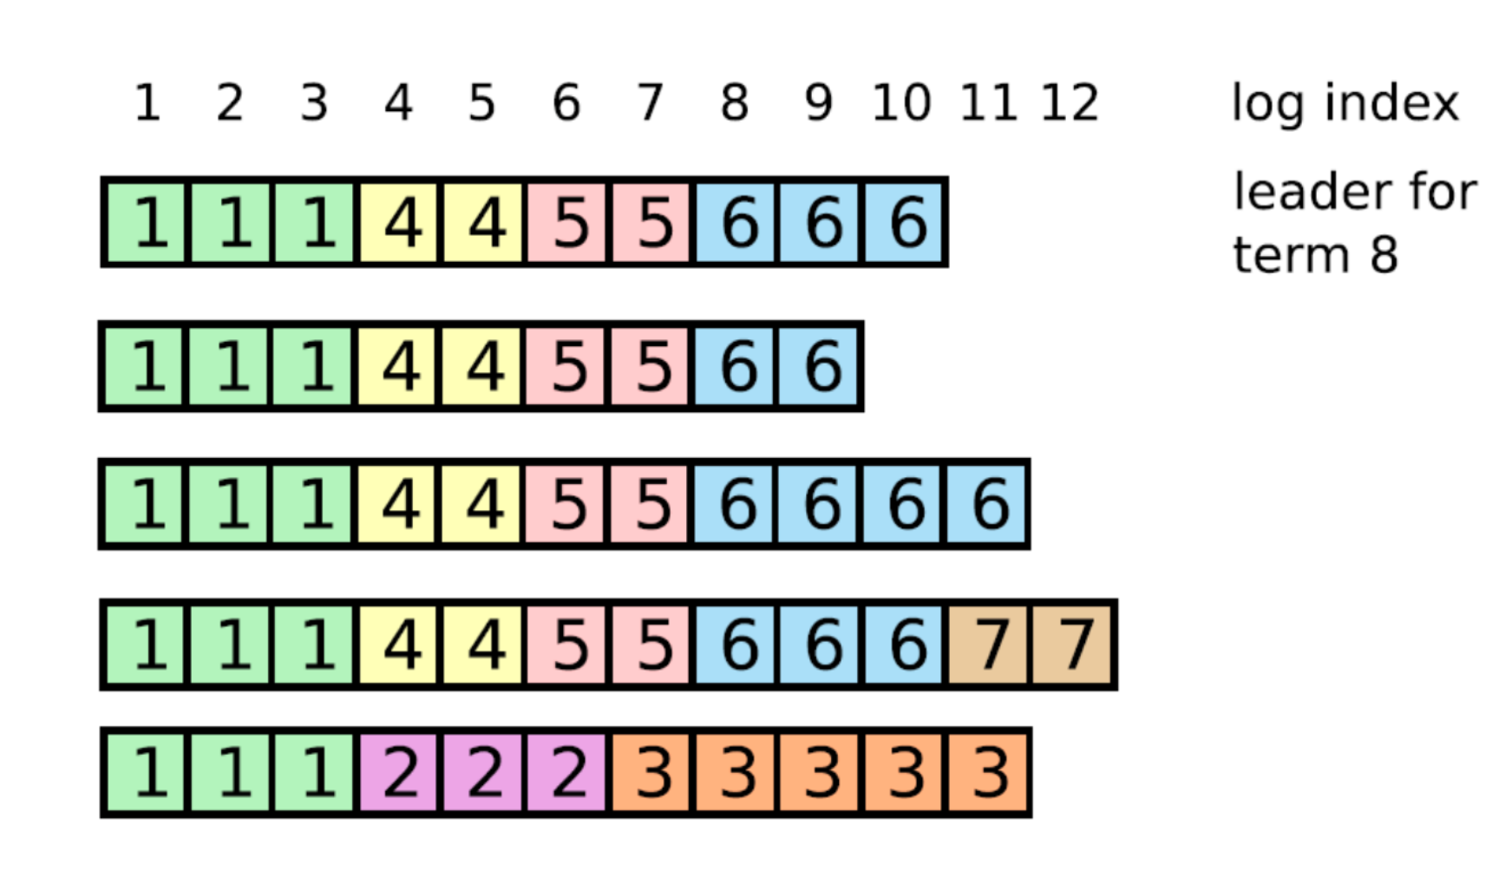
Raft
Roles: Leader, Follower, Candidates
Leader election per term
Log replication
Leader replicates log to all followers
Restrictions on leader election to enforce safety

Slide 70
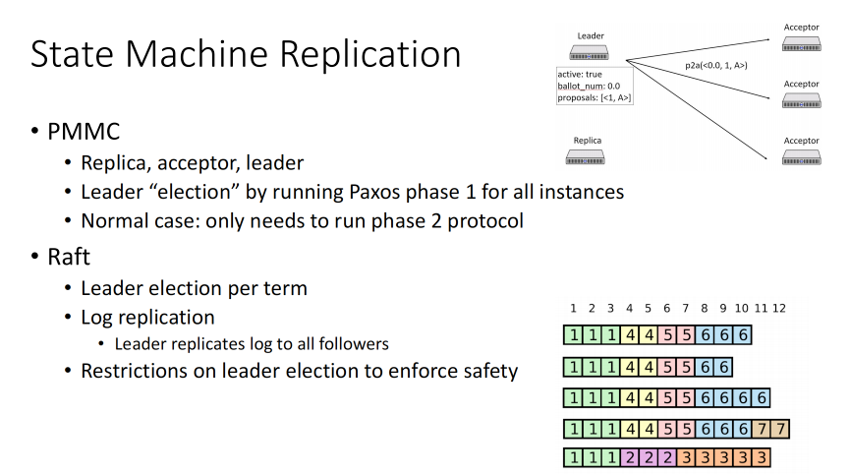
Consensus Protocols: Paxos

Slide 71
Consensus Protocols
Questions:
Does Paxos resolve the Two Generals’ problem?
No, because Paxos can reach consensus on majority decisions. Cannot be applied while there is only two machines.
What service is using consensus protocols?
Raft: ETCD, Kafka
Paxos: Zookeeper(Paxos Variant)

Slide 72
TOC
Why Distributed Systems?
Two-Generals’ Problem
RPC semantics
Distributed State & Consistency
Fault Tolerance & State Machine Replication
Consensus & Consensus Protocol
Distributed Transaction
More
Q&A

Slide 73
Distributed Transactions

Slide 74
Traditional Transaction
In single-node DB
Guarantees of a transactional system (ACID)
Atomicity
Either all operations executed (commit), or nothing (abort)
Consistency
Changes within a transaction are consistent with application constraints
Isolation
All transactions run in an “isolated” environment
MySQL: READ UNCOMMITTED , READ COMMITTED , REPEATABLE READ , and SERIALIZABLE
Durability
transaction effects are persisted

Slide 75
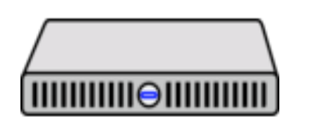
Distributed Transaction (Wrong)
You are going to book either three events or no events
Badminton Playground
Restaurant
Cinema
yes
yes

Slide 76
Distributed Transaction (Wrong)
You are going to book either three events or no events
Badminton Playground
Restaurant
Cinema
No
Ends up only book two events, not expected

Slide 77
Distributed Transaction (Correct)
You are going to book either three events or no events
Badminton Playground
Restaurant
Cinema
Maybe book
yes
Maybe book
yes

Slide 78
Distributed Transaction (Correct)
You are going to book either three events or no events
Badminton Playground
Restaurant
Cinema
No

Slide 79
Distributed Transaction (Correct)
You are going to book either three events or no events
Badminton Playground
Restaurant
Cinema
No
No

Slide 80
Distributed Transaction (Two Phase Commit)
Roles:
Participants
Coordinator
Actions
RPC request
Log before sending RPC
RPCs:
Coordinator -> Participants, PREPARE:
Can you accept this transaction?
Participants -> Coordinator, Vote:
I can accept.
Coordinator -> Participants, COMMIT:
Commit this transaction
Participants -> Coordinator, ABORT:
Abort this transaction

Slide 81
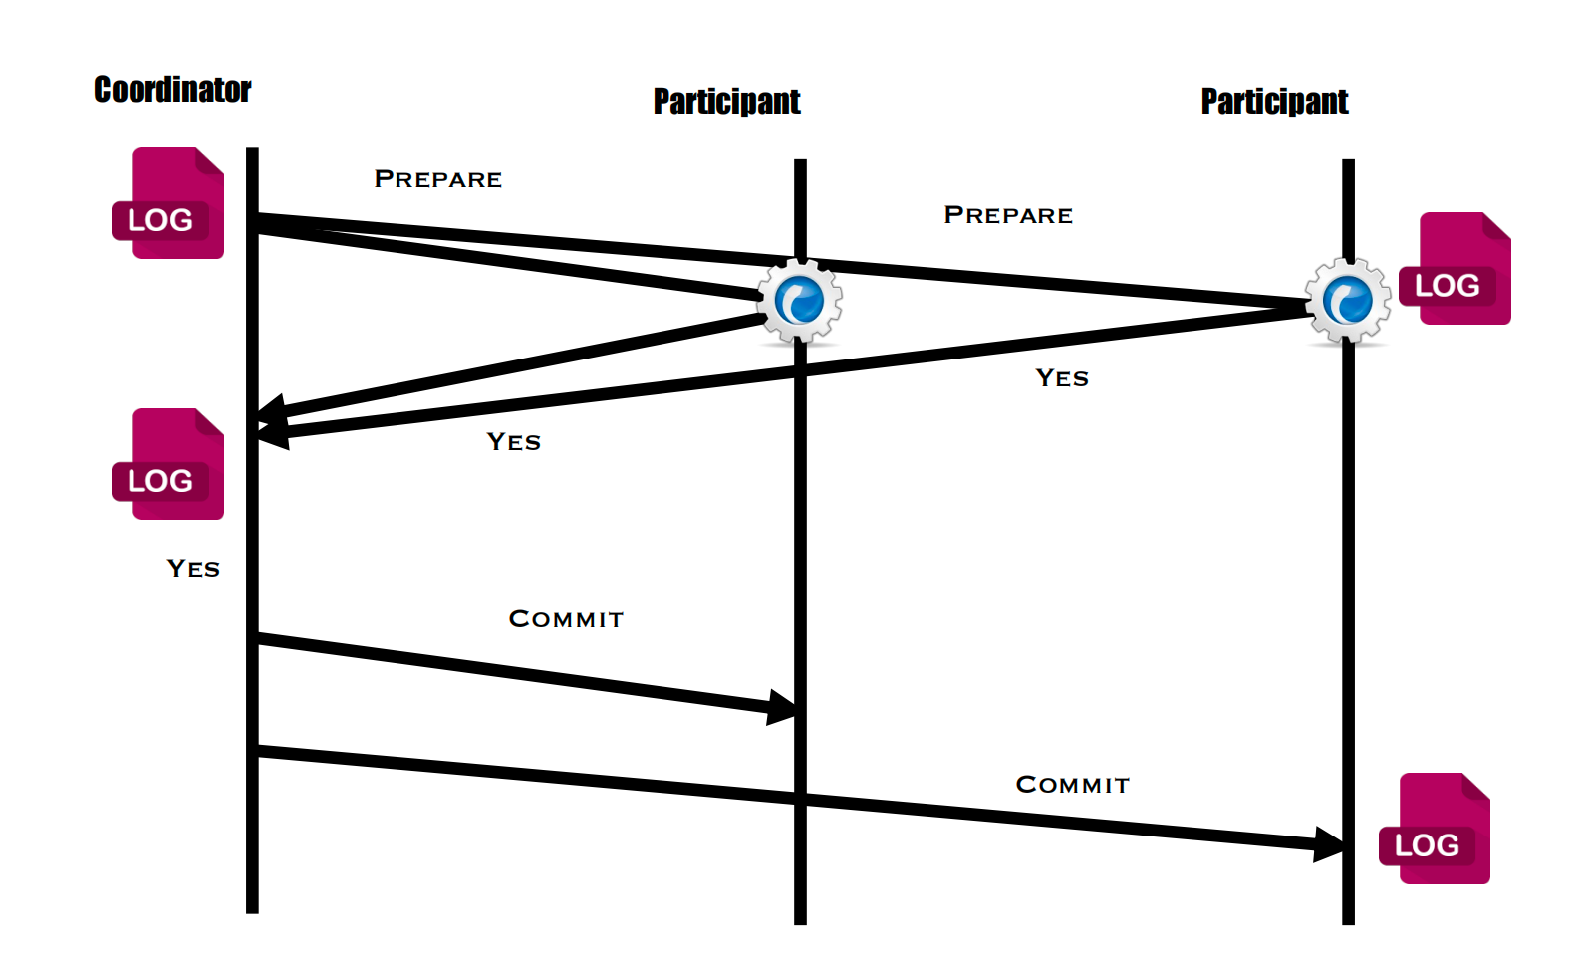
Distributed Transaction (Two Phase Commit)
Commit without failures

Slide 82
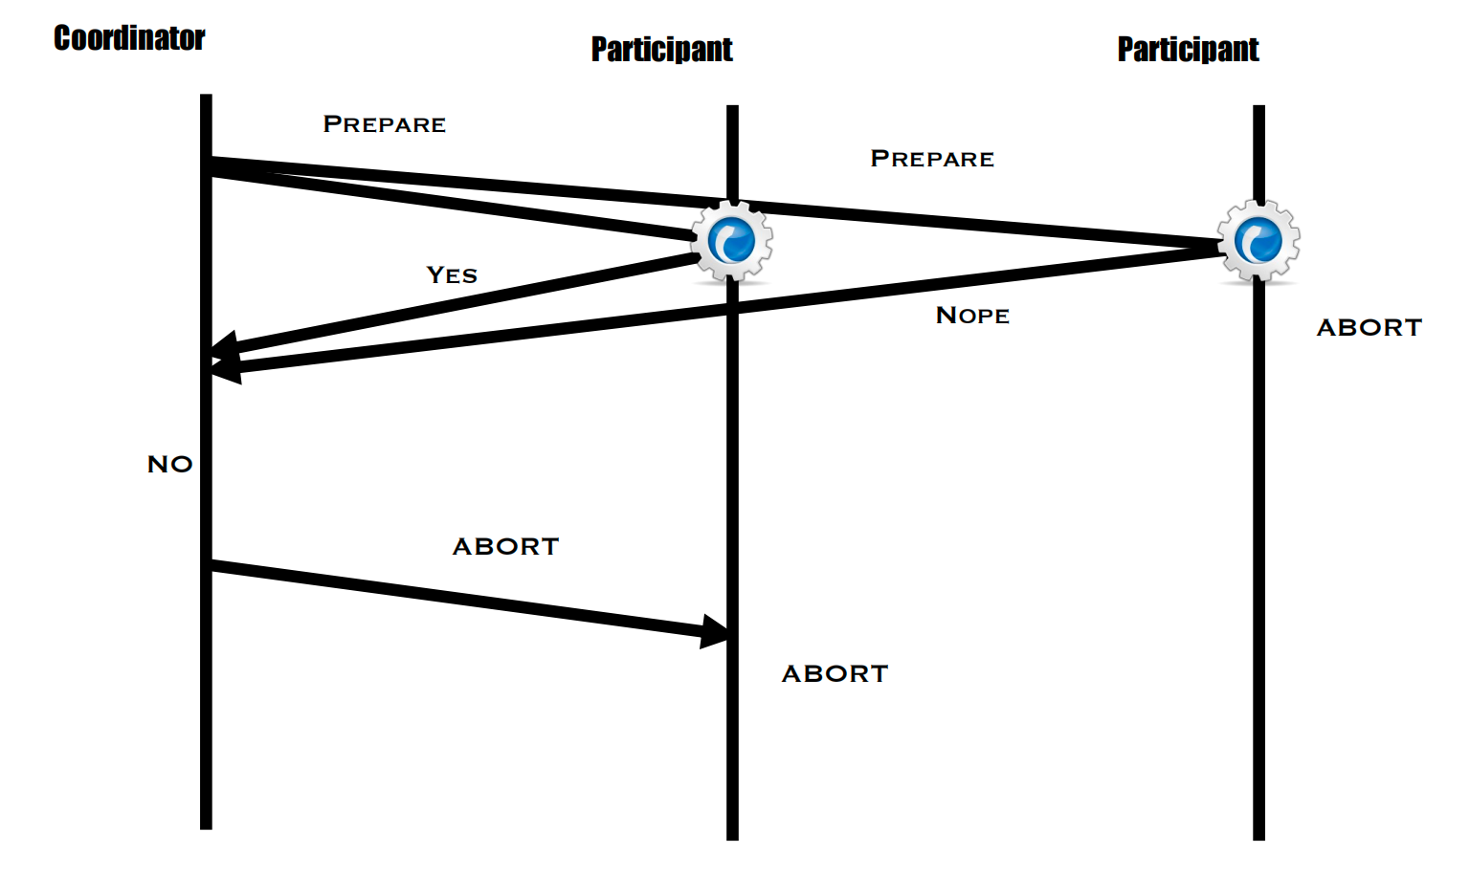

Distributed Transaction (Two Phase Commit)
Abort without failures

Slide 83
Distributed Transactions
In the absence of failures, 2PC is pretty simple
What if failures happen?
Participant failures?
Coordinator failures?
Message drops?

Slide 84
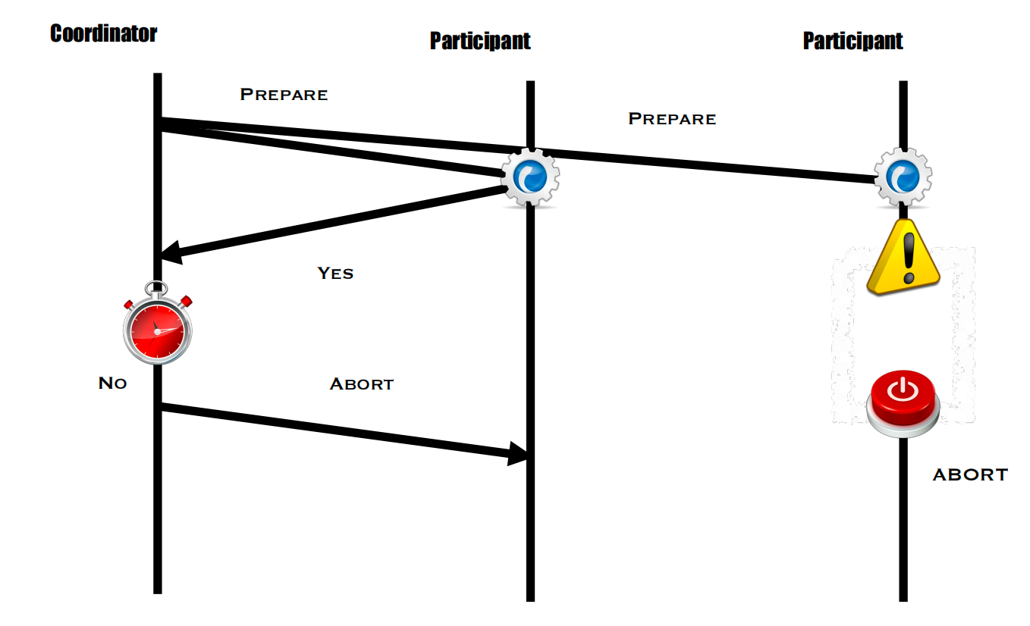
Distributed Transactions
Participants fails before sending response
Fails and recover

Slide 85
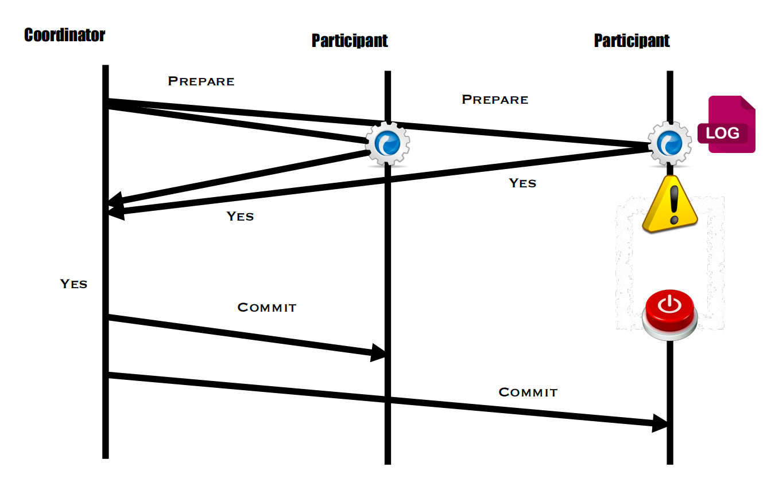
Distributed Transactions
Participants fails after sending vote

Slide 86
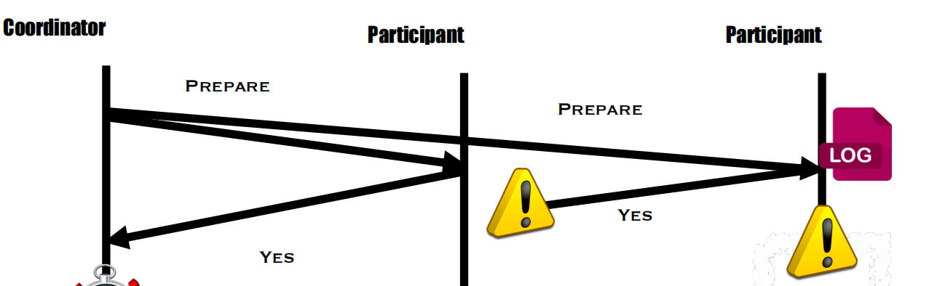
Distributed Transactions
What if participant fails after sending vote, but the vote is lost?
After recovery, should participant commit again?

Slide 87
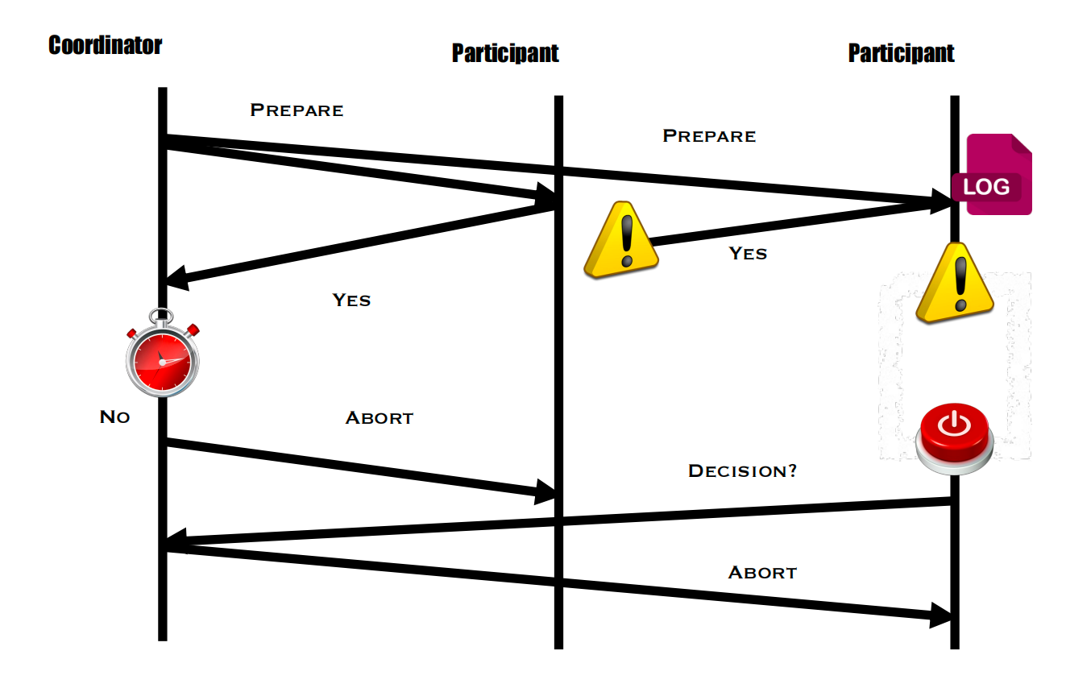
Distributed Transactions
What if participants fails after sending vote, but the vote is lost?
Can commit again, or ask for decision. Either way, the coordinator should tell participant the result.

Slide 88
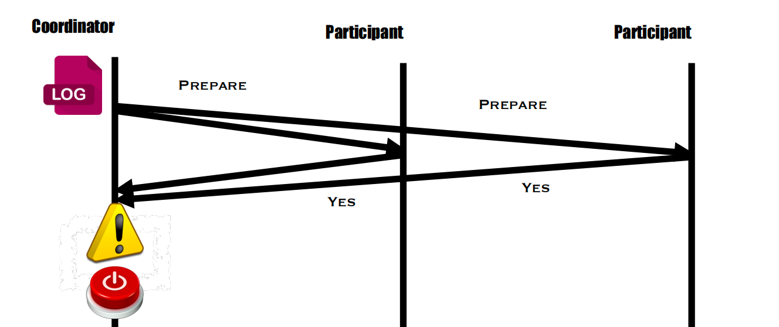
Distributed Transactions
Coordinator fails before sending decision?
After recovery, should coordinator commit the transaction?

Slide 89
Distributed Transactions
Coordinator fails before sending decision?
After recovery, should coordinator commit the transaction?
Shouldn’t, it should prepare again or simply abort.

Slide 90
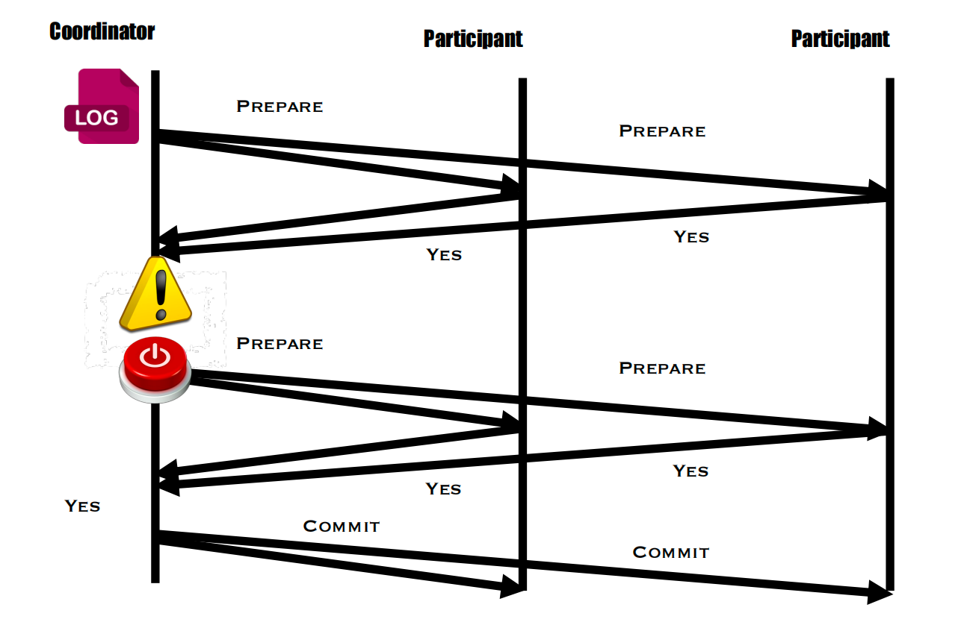
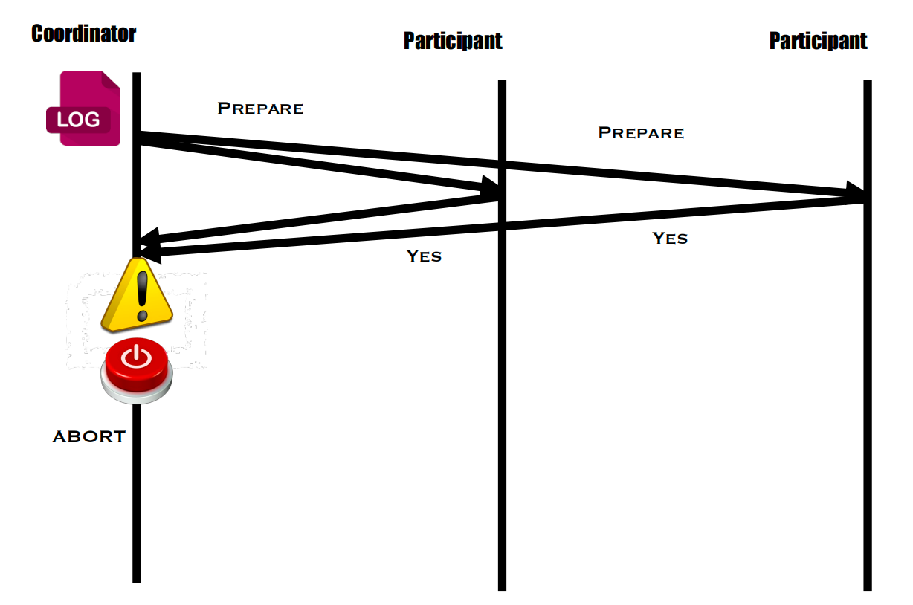
Distributed Transactions
Coordinator fails before sending decision?
After recovery, should coordinator commit the transaction?
Shouldn’t, it should prepare again or simply abort.

Slide 91
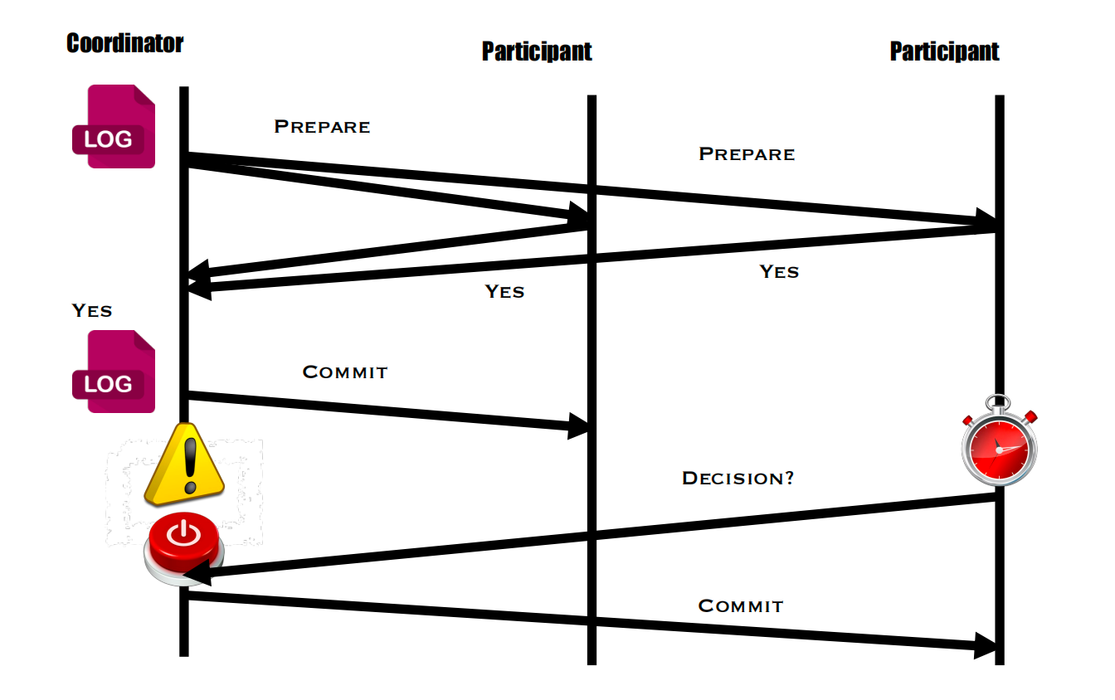
Distributed Transactions
Coordinator fails after sending decision?
Should we abort?

Slide 92
Distributed Transactions
Coordinator fails after sending decision?
Should we abort? No! Because there is log.

Slide 93
Distributed Transactions
Other Concurrency Control Protocols
Optimistic concurrency control (OCC)
Timestamp ordering (TO)
Multiversion concurrency control (MVCC)
Many others…

Slide 94
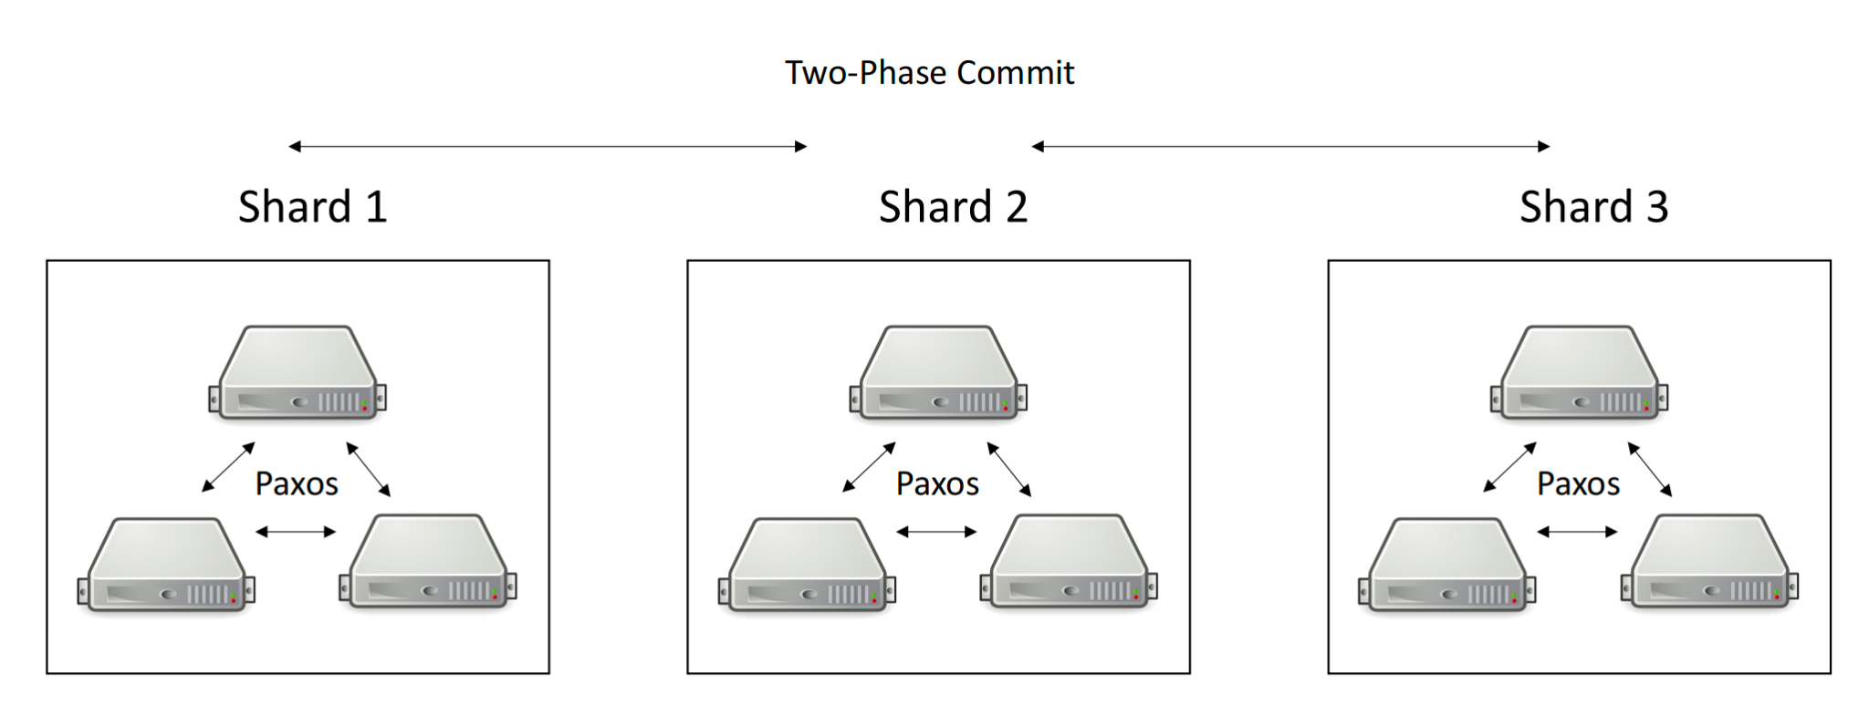
Put it together

Slide 95
TOC
Why Distributed Systems?
Two-Generals’ Problem
RPC semantics
Distributed State & Consistency
Fault Tolerance & State Machine Replication
Consensus & Consensus Protocol
Distributed Transaction
More
Q&A

Slide 96
More
Byzantine Fault Tolerance
Distributed File Systems
Distributed Storage
Distributed Computing
MLsys

Slide 97
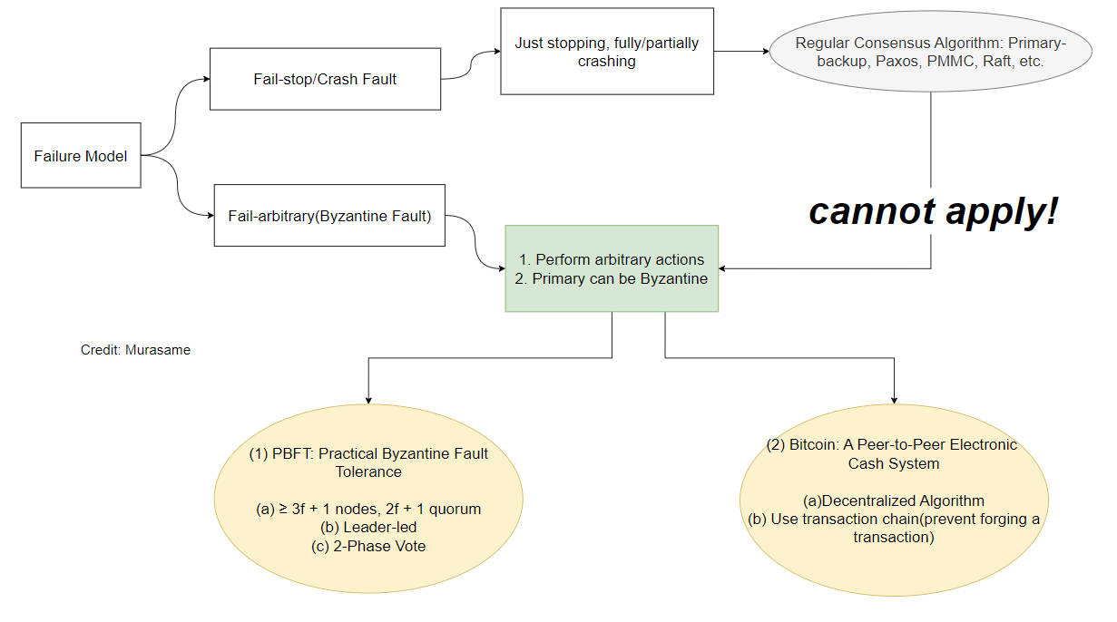
Byzantine Fault Tolerance

Slide 98
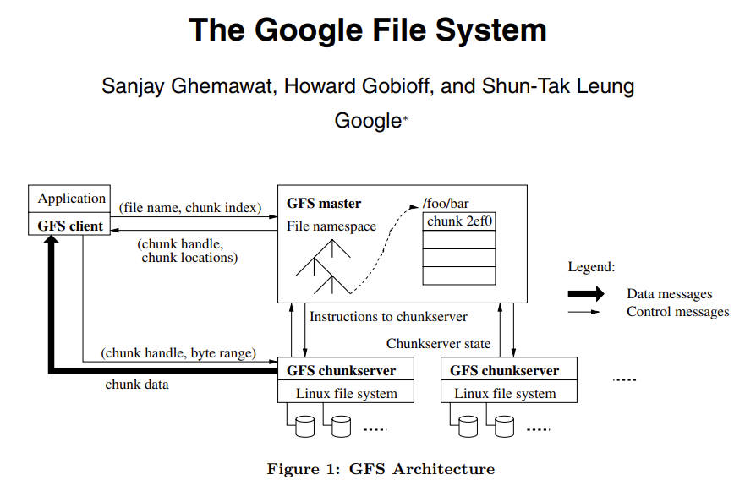
Distributed File Systems

Slide 99
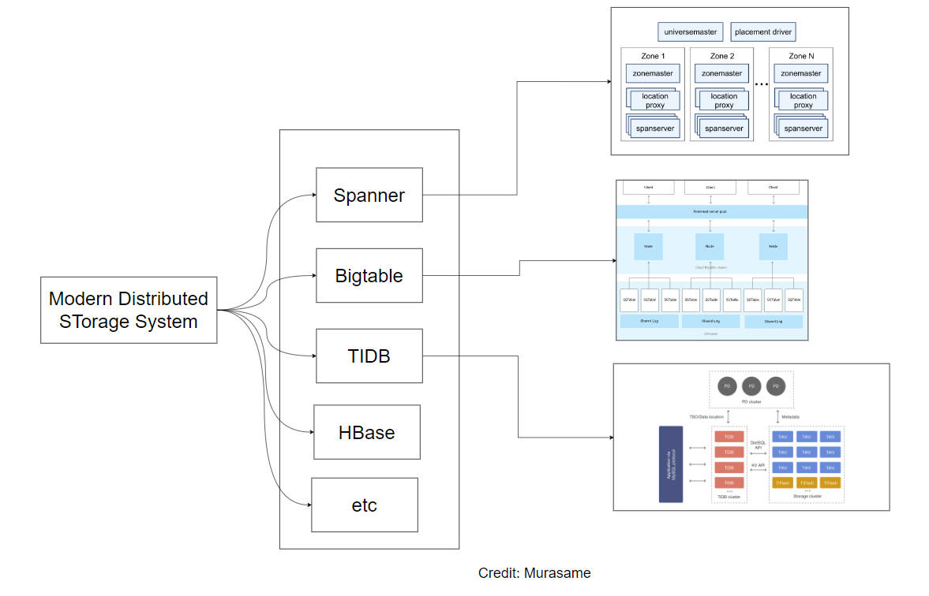
Distributed Storage

Slide 100
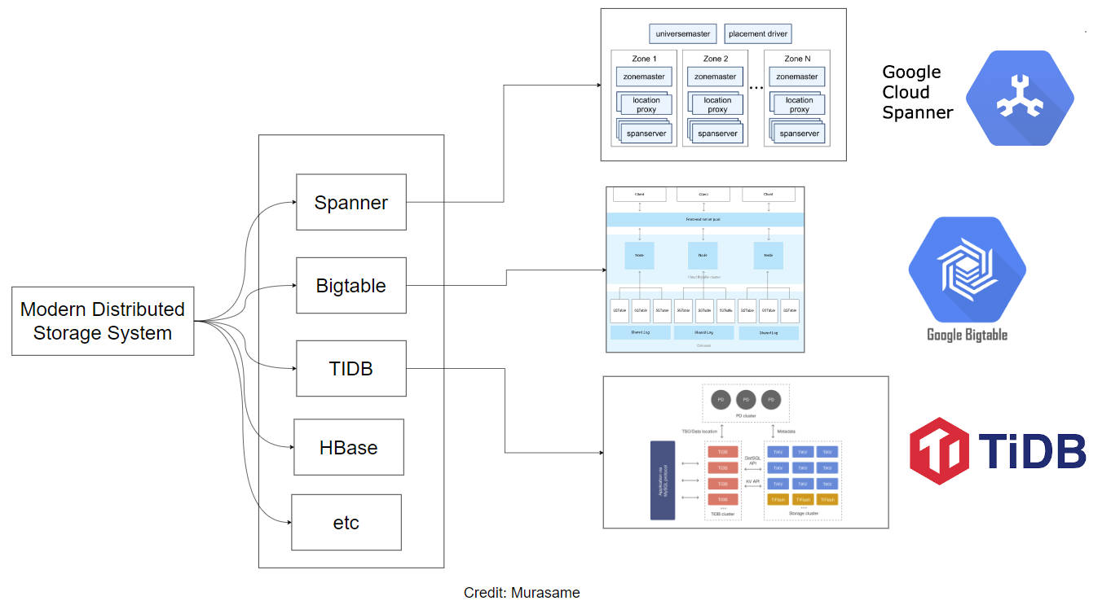
Distributed Storage

Slide 101
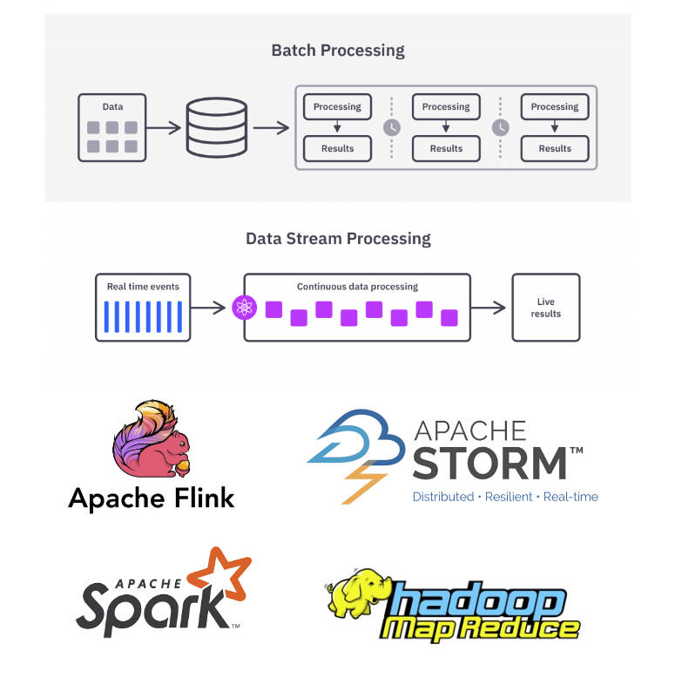
Distributed Computing

Slide 102
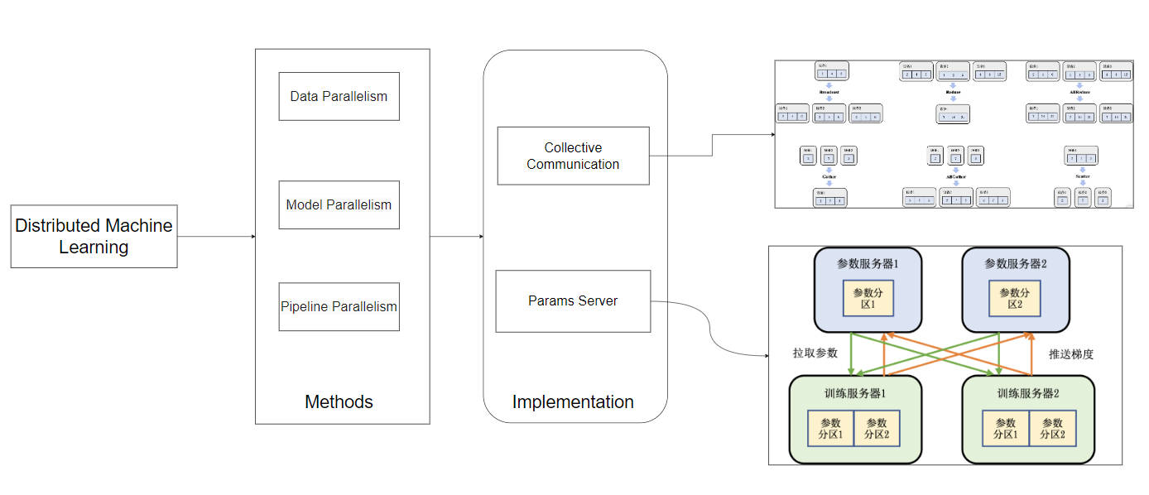
Distributed Machine Learning Systems

Slide 103
Q&A

